Slide 1

Professional Agricultural Organizations

Slide 2
Agricultural Education
FFA
SAE
Classroom Instruction

Slide 3
National FFA Organization
The National FFA Organization has members across the U.S.
Premier youth organization for students in agricultural education.
Over 500,000 members nationally.
  All 50 states plus Puerto Rico & the Virgin Islands

Slide 4
FFA Emblem

Slide 5
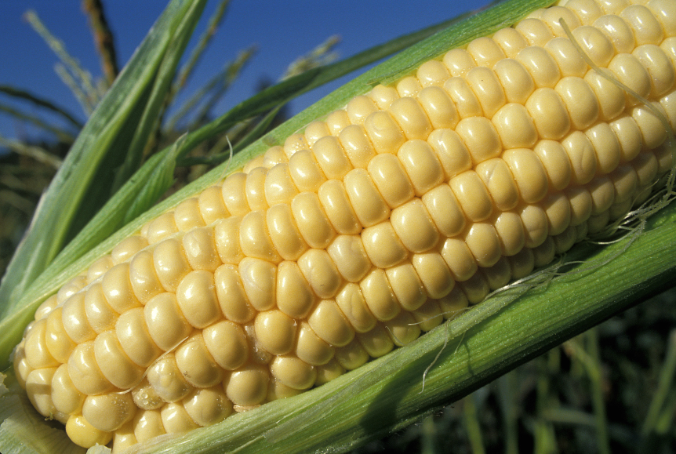
FFA Emblem
Cross-section of the ear of corn:
  Serves as the foundation for the emblem just as corn has historically served as the foundation crop of American agriculture.
  Symbol of unity because corn is grown in all 50 states.

Slide 6
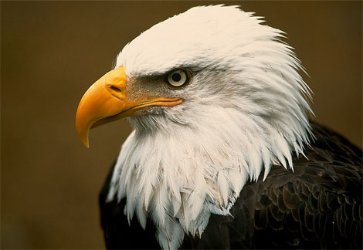
FFA Emblem
Eagle:
  National symbol.

Slide 7

FFA Emblem
Rising Sun:
  Signifies progress and promises that tomorrow will bring a new day glowing with opportunity.

Slide 8
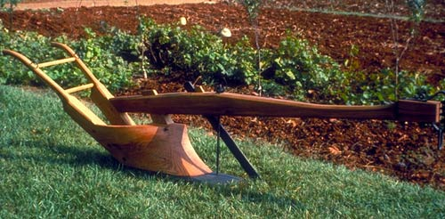
FFA Emblem
Plow:
  Signifies labor and tillage of the soil.
  The backbone of agriculture and the historic foundation of our country’s strength.

Slide 9
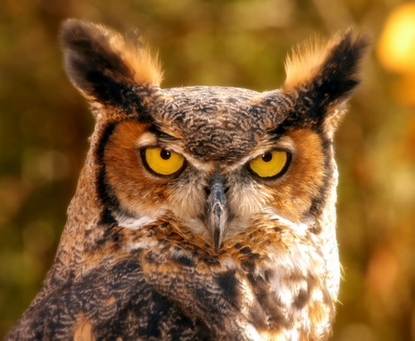
FFA Emblem
Owl:
  Symbolizes the knowledge required to be successful in the industry of agriculture.
  Long recognized for wisdom.

Slide 10
FFA Emblem
Words “FFA” & “Agricultural Education”:
  Signifies the combination of learning and leadership necessary for progressive agriculture.

Slide 11
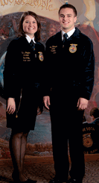
FFA Official Dress
Males:
  Black pants
  White collard shirt
  Official FFA tie
  Official FFA jacket
  zipped to the top
  Black shoes and socks

Slide 12
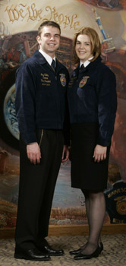
FFA Official Dress
Females:
  Black skirt of appropriate
  length or pants.
  (Only pants for approved events)
  White collard shirt
  Official FFA scarf
  Official FFA jacket
  zipped to the top
  Black shoes and
  black hose.

Slide 13

FFA Colors and Structure
National FFA Organization
↓
North Carolina FFA Association
↓
East Central Region
↓
Johnston Federation
↓
Cleveland FFA Chapter
National Blue
Corn Gold

Slide 14

National FFA Advisor
Dr. Larry Case

Slide 15

North Carolina State Agricultural Education Coordinator
Joshua Bledsoe

Slide 16
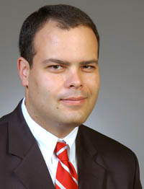
North Carolina State FFA Coordinator
Jason Davis

Slide 17
Types of FFA Membership
Active
  Students in middle school, high school and college up to age 21.
Alumni
  Former active members, parents of FFA members, and others interested in and supporters of FFA.
Collegiate
Honorary
  Local, state and national levels.

Slide 18
Serving as an Officer
Allows you to work as a team.
Helps develop leadership skills.
Members can serve as officers at all levels of the FFA:
  Chapter
  Regional
  State
  National

Slide 19
Officer Roles
President:
  Stationed by the Rising Sun.
  Presides over meetings.
Vice President:
  Stationed by the Plow.
  Coordinates Committees.

Slide 20
Officer Roles
Secretary:
  Stationed by the Ear of Corn.
  Keeps accurate minutes at meetings.
Treasurer:
  Stationed by the emblem of Washington.
  Keeps financial records.

Slide 21
Officer Roles
Reporter:
  Stationed by the flag.
  Informs the public about the FFA.
Sentinel:
  Stationed by the door.
  Helps maintain order.

Slide 22
Officer Roles
Advisor:
  Stationed by the owl.
  Provides guidance and assistance for all FFA activities.

Slide 23
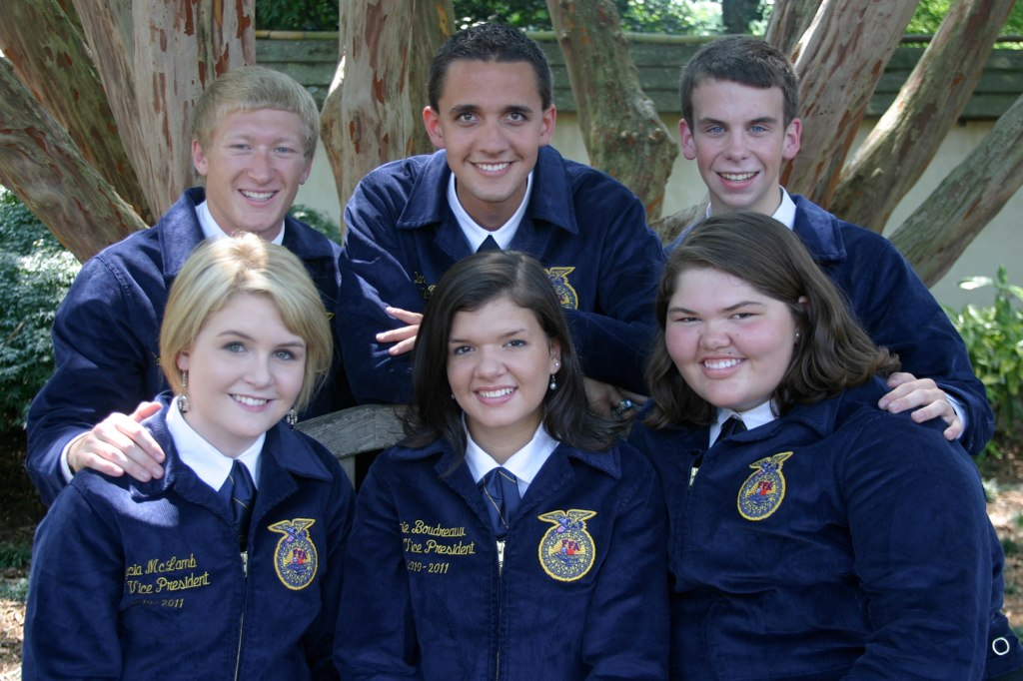
State Officers
1 President & 5 Vice Presidents

Slide 24
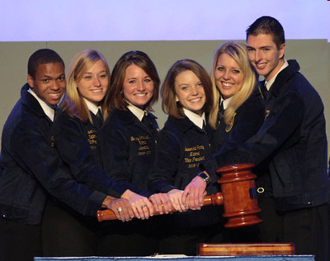
National Officers
1 President, 1 Secretary & 4 Regional Vice Presidents

Slide 25
FFA Salute:
The Pledge of Allegiance
“I pledge allegiance to the flag of the United States of America and to the republic for which it stands, one nation under God, indivisible, with liberty and justice for all.”

Slide 26
Leadership Conferences
Regional Level:
  Regional Leadership Conference
State Level:
  State Leadership Conference
  LEAD Conference (For Chapter Officers)
  MEGA Conference
National Level:
  Washington Leadership Conference

Slide 27
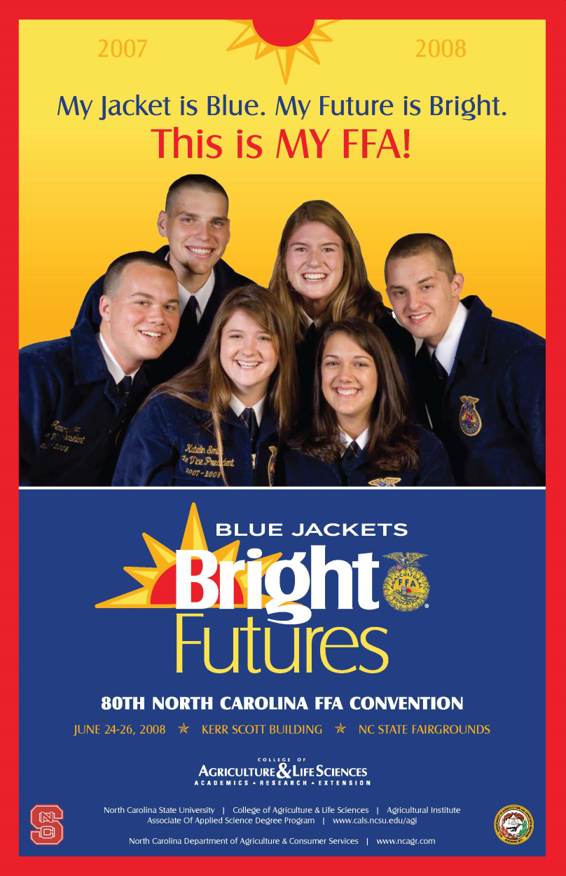

FFA Conventions
State FFA Convention
  June
  Raleigh, NC
National FFA Convention
  October
  Indianapolis, IN

Slide 28

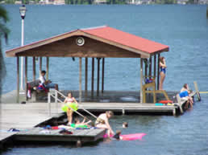
FFA Camp
North Carolina FFA Center
  White Lake, NC
  FFA Summer Recreational Camp

Slide 29
Greenhand FFA Degree
Given at the Chapter Level.
Requirements:
  Have satisfactory plans for a Supervised Agricultural Experience Program.
  Learn & Explain the FFA Creed, motto, salute and FFA mission statement.
  Describe and explain the meaning of he FFA emblem and colors.
  Demonstrate a knowledge of the FFA Code of Ethics and the proper use of the FFA jacket.

Slide 30
Greenhand FFA Degree
Requirements Continued:
  Demonstrate a knowledge of the history of the organization, the chapter constitution and bylaws and the chapter program of activities.
  Personally own or have access to the Official FFA Manual and the FFA Student Handbook.
  Submit written application for the degree.

Slide 31
Chapter FFA Degree
Given at the Chapter Level.
Requirements:
  Must have received the Greenhand FFA Degree.
  Must have completed at least one agricultural education course at the high school level.
  Must have in operation an approved supervised agricultural experience program.
  Must have participated in the planning and conducting of at least three official functions in the chapter Program of Activities.

Slide 32
Chapter FFA Degree
Requirements Continued:
  Must have earned at least $150 or worked at least 45 hours in excess of scheduled class time. (Or a combination of both)
    Also must have plans for the continued growth and improvement of the SAE.
  Have effectively led a group discussion for 15 minutes.
  Have demonstrated five procedures of parliamentary law.
  Have a satisfactory scholastic record.
  Submit a written application for the degree.

Slide 33
State FFA Degree
Given at the State Level.
Requirements:
  Must have received the Chapter FFA Degree.
  Must have completed at least two years of agricultural education courses.
  Have earned and productively invested at least $1,000 or worked at least 300 hours in excess of regularly scheduled class time.

Slide 34
American FFA Degree
Given at the National Level.
Requirements:
  Must have received the State FFA Degree.
  Must have been an active member for the past three years.
  Must have a record of satisfactory participation in the activities on the chapter and state levels.
  Must have completed at least three agricultural education courses.

Slide 35
Opening Ceremony: “All in Unison”
President:
“FFA members, why are we here?”
Members:
“To practice brotherhood, honor agricultural opportunities and responsibilities, and develop those qualities of leadership which an FFA member should possess.”

Slide 36
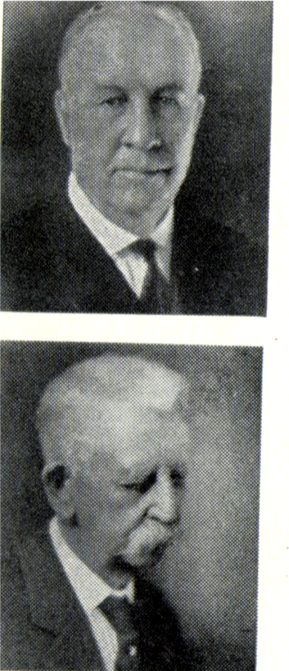
Important Events
1917
Event: Smith-Hughes Act is passed.
Importance: Established funding for vocational agriculture in high school.

Slide 37
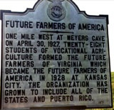
Important Events
1926
Event: Future Farmers of Virginia is formed.
Importance: First of these statewide clubs, served as a model for the FFA.
In North Carolina this was called the Young Tarheel Farmers.

Slide 38
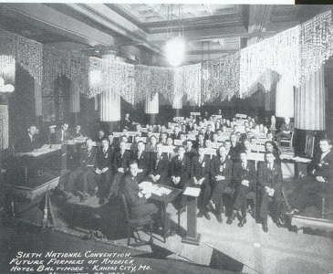
Important Events
1928
Event: FFA is formed in Kansas City.
Importance: Started the organization by 33 students.
Kansas City served as the location for national convention for over 50 years.

Slide 39
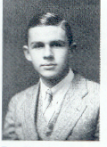
1928- Continued
Leslie Applegate of New Jersey became the 1st National FFA President.

Slide 40
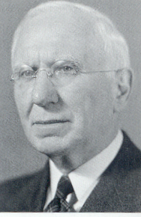
1928- Continued
Dr. C.H. Lane became the 1st National FFA Advisor.

Slide 41
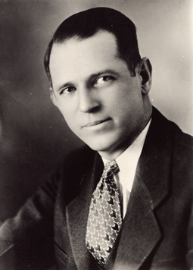
1928- Continued
Henry Groseclose of Virginia helped establish FFV and then became known as the “Father of FFA”.

Slide 42
1929
Event: North Carolina joins FFA.
Importance: Allows agricultural education students from North Carolina to participate in national FFA activities.
Lillington High School in Harnett County was the 1st FFA chapter in North Carolina.

Slide 43
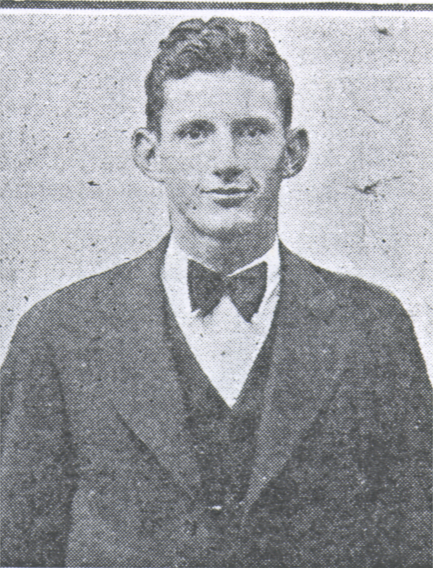
1929- Continued
Wade Turner from North Carolina became the 2nd National FFA President.

Slide 44
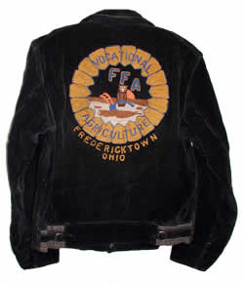

Slide 45
Important Events
1935
Event: New Farmers of America (NFA) is formed.
Importance: Established organization for African American boys interested in Agriculture.

Slide 46
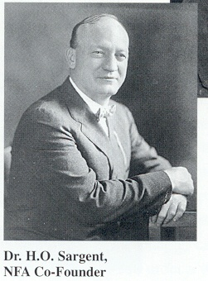
NFA
Dr. H.O. Sargent was a co-founder of the NFA.
Today the FFA gives an award in his memory to honor those that promote diversity in agriculture.

Slide 47
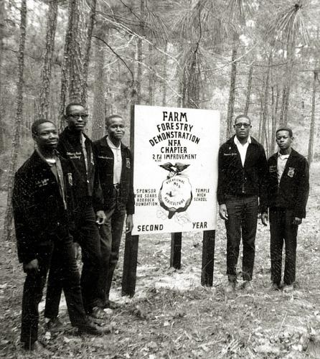
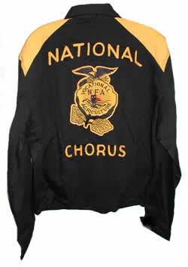

Slide 48
Important Events
1950
Event: Public Law 81-740 is passed by Congress.
Importance: Granted the FFA a federal charter, making FFA a required part of agricultural education programs.

Slide 49
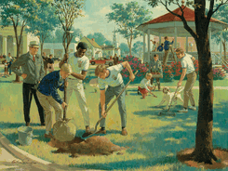
Important Events
1965
Event: NFA merges with the FFA.
Importance: Allowed all boys regardless of race to participate in the FFA.

Slide 50
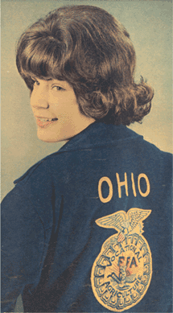
Important Events
1969
Event: Females are allowed to join FFA.
Importance: Made it possible for females to participate on all levels of FFA.

Slide 51
Important Events
1988
Event: Name is changed from FFA to National FFA Organization.
Importance: Recognizes the growth of science, business and technology in agriculture.

Slide 52
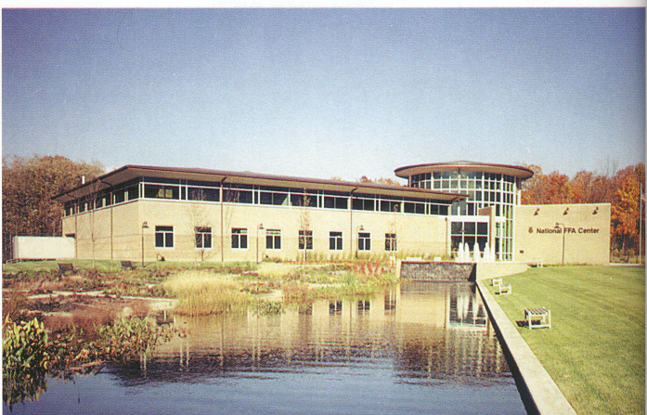
Important Events
1998
Event: The National FFA Center was moved to Indianapolis.
Importance: Provided a central location for the National FFA’s offices.

Slide 53
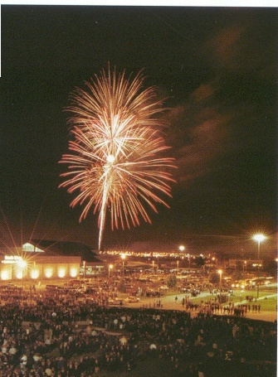
Important Events
1999
Event: National Convention moved to Louisville, KY.

