Slide 1
Animal Nutrition
Animal Science 1

Slide 2
Nutrition
Major groups of nutrients
Carbohydrates
Fats and Oils
Proteins
Vitamins
Minerals
Water

Slide 3
Carbohydrates
Main energy nutrients made up of sugars, starches, cellulose and gums.
Found in the largest quantities in livestock feed, chemically composed of carbon, hydrogen, and oxygen.
Main function is to provide energy

Slide 4
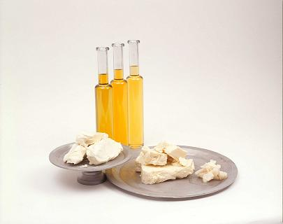
Fats and oils
2.25 times the energy of carbohydrates
At body temperature fats are solid and oils are liquid

Slide 5
Fats and Oils
They carry the fat-soluble vitamins.
Extra carbohydrates are stored as fat.
Fat is composed of carbon, hydrogen and oxygen.

Slide 6
Fats and oils
Provide 2-25 times the energy value of carbohydrates
Carry fat-soluble vitamins

Slide 7
Proteins
Organic compounds made up of amino acids.
Contains carbon, hydrogen, oxygen and nitrogen
Sometimes sulfur, phosphorus and iron.

Slide 8
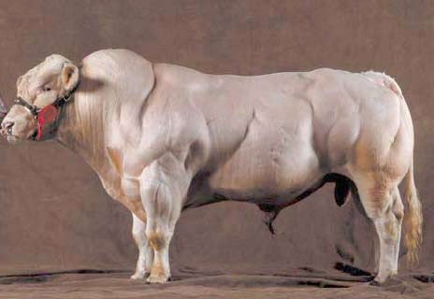
Proteins
Supply material to build body tissues such as muscles, skin and hair.
Belgian Blue

Slide 9
Vitamins
Trace organic compounds
Contains carbon
Helps regulate many body functions
Designated by letters such as A, B-complex, D, E, K

Slide 10
Vitamins
A : Healthy eyes, conception rate, disease resistance
B: Good bone development
C: Helps teeth and bone formation
D: Produced in animals body when they are in direct sunlight
Helps with the movement of calcium in the body
E: Muscle Development
K: Helps blood clot

Slide 11
Minerals
Inorganic materials or compounds needed in small amounts
Contains no carbon
Provide material for growth of bones, teeth and body tissue
Regulates many of the vital chemical body processes

Slide 12
Water
Makes up to 40 – 80% of an animal’s body
Helps dissolve other nutrients and carry them to different parts of the body
A vital factor in nutrition
Considered by many as the most important nutrient

Slide 13
Sources of nutrients
Carbohydrates –
cereal grains such as corn, wheat, oats, rye, barley, and sorghum
corn is most commonly used in United States
Fats and Oils –
grains and protein concentrates
Regular feed ingredients

Slide 14
Sources of nutrients
Proteins –
plant sources include soybean meal, cottonseed meal, alfalfa meal and animal sources include meat meal, fishmeal, dried milk and synthetic nitrogen source of urea
animal sources: fish meal, meat meal, plant sources: soybean meal, cottonseed meal

Slide 15
Sources of nutrients
Vitamins –
most feed ingredients, pre-mixes are added to feed
Minerals –
most feed ingredients, pre-mixes are added to feed
mineral blocks
Water –
usually supplied separate from other nutrients, liquid form
plumbing, wells

Slide 16
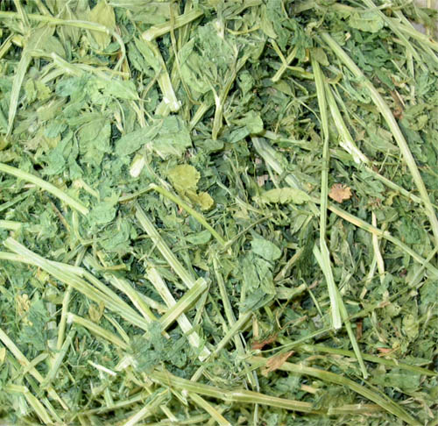
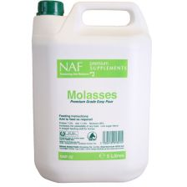
For ruminants, alfalfa hay provides some energy, protein and high fiber. Molasses can be added to improve taste (palatability) and reduce feed dust

