Slide 1
Board Warmer
Write questions, answer with video
What does the population do from 1970-2010?
What crop yields increased?
Do we use more fertilizer, or water?
How much of this can we attribute to the Biotech? How about to farmers?
What was the most surprising thing about this video?
Notes:
http://www.youtube.com/watch?v=joUggaD6Mr0&list=PL7B61381EE0438243

Slide 2
What are the two ages of medicine?

Slide 3
Board warmer
What is safety?
Why is safety important?
What would happen if safety procedures where not in place in a lab? What about in school or on the road?
Notes:
http://www.youtube.com/watch?v=gYwMhepuJMA – it only takes a second
http://www.youtube.com/watch?v=qqI1gafJA-4 – lab safety rap

Slide 4
Board Warmer
What is safety about?
What are the 2 commandments of safety this video goes over?
Are accidents preventable or do they just happen?
Notes:
http://www.youtube.com/watch?v=3C6js5JtCIQ Safety Video

Slide 5
Safety Groups
In groups of 3-4 discuss and write down the answers in your notes:
What are the 3 most unsafe things in your life?
How can you make them safer?
What are ways we make school safe?
How does being unsafe in the lab affect other students?

Slide 6
“Your own safety is at stake when your neighbor's wall is ablaze.” Horace
Write then answer:
1. How do other peoples actions effect your own?
2. How do your actions affect others safety?
3. Does this quote say we can just watch out for just ourselves? If not what does it say?

Slide 7
Lab Safety-video
What should you not wear?
What should you locate?
What should you do before you leave the lab?
What are a few of the general safety principals to follow?
Notes:
http://www.youtube.com/watch?v=ny9suF3DvcE

Slide 8
Biotechnology and Safety
9.01: Explain safety rules for a biotechnology laboratory

Slide 9
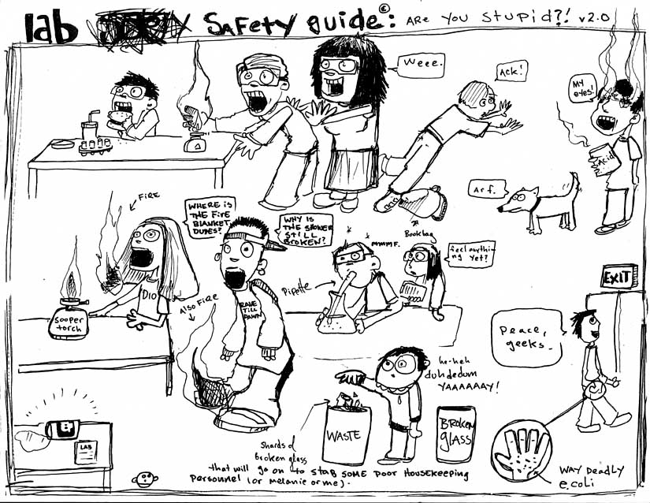

Slide 10
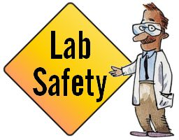
Safety Equipment
Eye Protection
Lab Coats
Gloves
Fire Protection Equipment
Material Storage Cabinets
Eye Wash Shower
Fume Hood

Slide 11
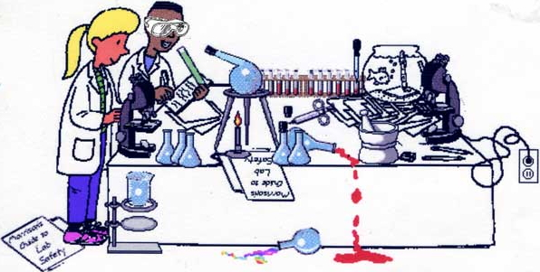

Slide 12
Safety Equipment
Eye Protection- safety glasses, safety goggles, or face shield
a. Used to protect eyes and face from spills or splashes, one of the most common accidents in labs.
b. Face shields offer the most protection.
c. Never lay face down to avoid scratches.

Slide 13
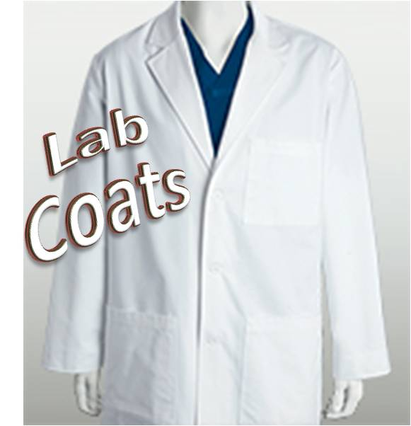
Safety Equipment
2. Lab Coats- protect body and clothes from spills, contribute to sterile environment

Slide 14
Safety Equipment
3. Gloves- usually surgical style, thin plastic, offer some protection and are used to achieve aseptic conditions

Slide 15
Safety Equipment
4. Fire Protection Equipment- fire blanket, fire extinguisher, fire alarm
a. Should be easily accessible and clearly marked.
b. In order to extinguish a fire, the fuel of the fire must be known.
c. Fire extinguisher should be rated for chemical and / or liquid fires.
Classes of fire extinguishers:
Class A – paper / wood
Class B – liquids
ClassC – electrical
Class D – combustible metals
d. Fire extinguisher should be aimed at the base of flames and used until flames are completely extinguished.
e. Fire blankets are most effective for smothering small flames on an individuals clothing or person.

Slide 16
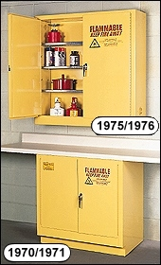
Safety Equipment
5. Materials Storage Cabinets
a. Flammables- most common, isolates flammable chemicals for safety, should contain chemicals ONLY. (fire resistant, not fire proof)
b. Acids- isolate chemicals with specialized spill containers

Slide 17
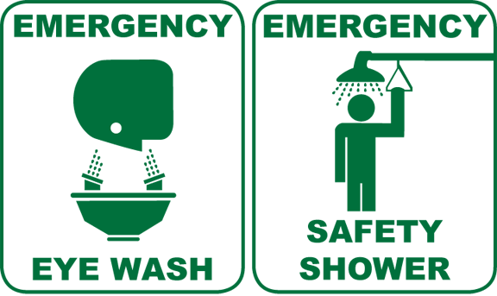
Safety Equipment
6. Eye Wash / Shower- should be checked often, but used only in the case of emergency.
a. After chemical exposure, eyes should be rinsed for more than a minute to ensure that damage is limited as much as possible.

Slide 18
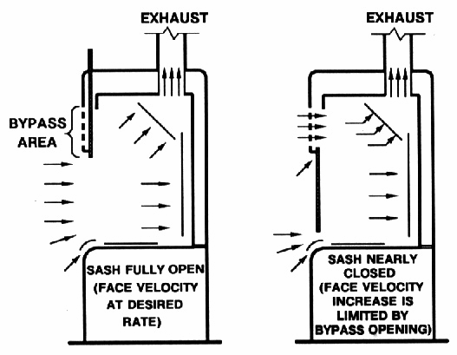
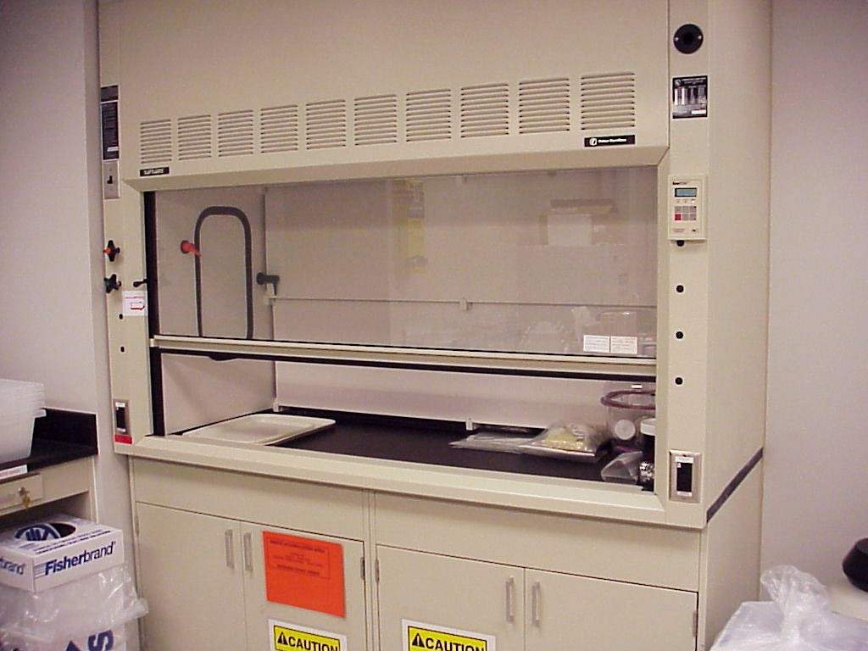
Safety Equipment
7. Fume Hood- expensive piece of equipment that removes noxious fumes produced by chemical solutions from the laboratory.

Slide 19
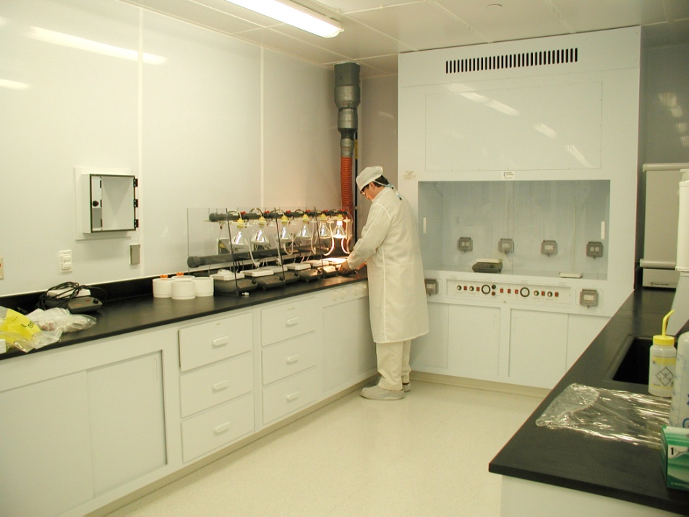
Safety Principles
1. Keep the workspace clean and clear of any obstructions and excess equipment, people, and / or supplies.
2. Keep supplies and equipment in an easily accessible location.

Slide 20
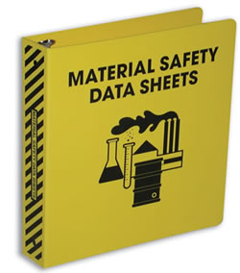
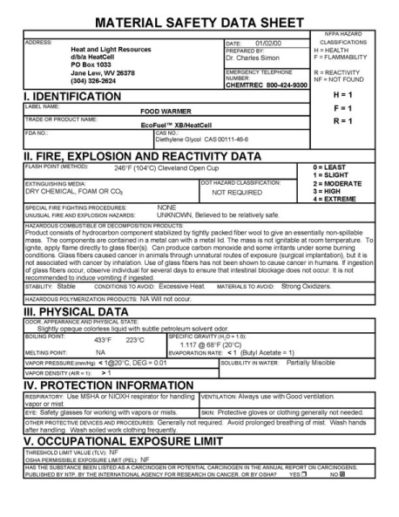
Safety Principles
3. Make certain that chemicals are clearly labeled with Material Safety Data Sheets (MSDS) well marked and easily accessible.
a. MSDS sheets contain important information on chemicals including; chemical properties, storage, disposal, and treatment for exposure.

Slide 21
Safety Principles
4. Chemical Spills & Exposure
a. Spills should be quickly contained and the area secured.
b. Special media can be used to absorb harmful chemicals.
c. Any exposed skin should be immediately rinsed or neutralized, (in the case of an acid / base) particularly with eye exposure MSDS sheets should be consulted for further treatment.
i) A mild acid can at times be used to neutralize areas exposed to a strong base. (works both ways)
d. Chemicals consumed orally should be treated using the chemical’s MSDS sheet.

Slide 22
Biotechnology and Safety
9.02: Outline procedures for achieving and maintaining aseptic conditions during biotechnology laboratories.

Slide 23
Principles for Handling Chemicals
1. Only use chemicals that are properly labeled, with current MSDS sheets.
2. Use only approved containers for mixing and storing chemical solutions.
3. Use a graduated cylinder or digital scale to ensure that the proper amount of chemicals are added to a solution.
4. When pouring liquid chemicals, place containers in contact whenever possible to prevent spills.

Slide 24
Principles for Handling Chemicals
5. Do not leave chemicals unattended outside of storage areas.
6. When creating acid solutions, acids should always be poured slowly into water, to prevent splashing.
7. Federal law requires chemicals to be diluted before disposal being careful not to mix chemicals that react violently.

Slide 25
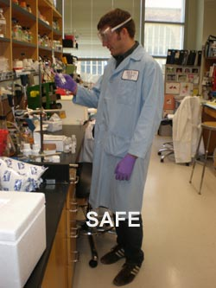
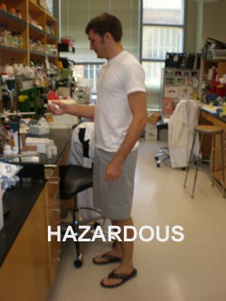

Slide 26
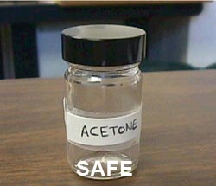
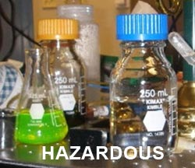

Slide 27
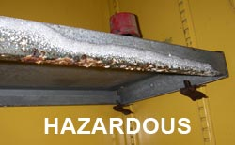
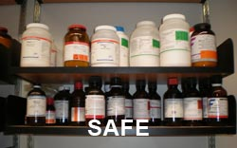
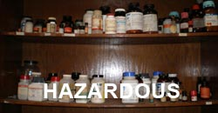

Slide 28
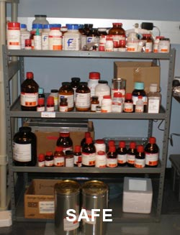
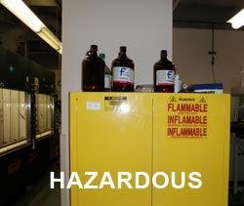

Slide 29
Principles for Handling Chemicals
**Make certain that all necessary permits are obtained from government regulatory agencies for the use of restricted chemicals and biologicals.

Slide 30
Sterilizing Equipments and Materials
1. An autoclave is the best method for sterilization of small lab equipment, water / solutions, glassware, and lab materials. (even paper towels and cotton swabs can be sterilized)
a. Autoclaves will KILL live material…
2. Flow hoods and surfaces can be cleaned / disinfested with a bleach based solution.
3. Forceps and other equipment should never be placed in contact with surfaces, but placed in a 70% ethanol (alcohol) solution, and flamed over an alcohol lamp before contacting sterile material.

Slide 31
Creating a Sterile Environment
1. Tissue culture and other aseptic lab techniques work best in a clean room or under a LAMINAR FLOW HOOD.
a. Laminar flow hoods use a special filter (hepa filter) to clean air that needs changed after a given number of hours.
b. Sterile boxes can be created with plexiglass or plastic sheeting for a more affordable but less reliable alternative.
2. Once the area is sterilized the movement of equipment and materials into and out of the work area should be minimized.

Slide 32
Maintaining Sterile Conditions
1. A face shield or front cover should be used to prevent contamination from mouth and nose (breathing).
2. Hands / Arms
a. Should be carefully washed with soap and water
b. An anti-bacterial soap should be used on hands over wrists, immediately before placement in sterile surgical gloves.
c. Hands should be kept inside the air curtain of the flow hood at all time away from the edge or entrance to avoid accidental contamination.
3. Sleeves should be away from hands and shedding materials should be avoided- a lab coat is ideal.

Slide 33
Biotechnology and Safety
9.03: Prepare reagents and solutions while observing safe laboratory protocol in accordance with Material Safety Data Sheets.

Slide 34
Tips for Preparing Solutions
1. Material Safety Data Sheets (MSDS) provide all the information necessary for storage, handling and disposal of a chemical or solution.
a. Includes- the chemical formula, reactivity data, storage temps, exposure / inhalation / ingestion treatment, disposal methods, dangers with use, etc.
b. Should be easily accessible in the lab.

Slide 35
Tips for Preparing Solutions
2. Make certain to clearly label the COMPOSITION and STRENGTH of all solutions.
a. Under concentrated solutions can be ineffective.
b. Over concentrated solutions can be extremely dangerous.

Slide 36
Tips for Preparing Solutions
3. When mixing chemicals:
a. Always pour concentrated acids INTO cool water (NOT THE OTHER WAY AROUND)
b. Pour with beakers or bottles in contact when possible, running the liquid down the side of the glass to avoid splashing or flash boiling.
c. KNOW WHAT YOU ARE COMBINING / CREATING!

Slide 37
Tips for Safe and Effective us of Biological materials
1. Biological materials should be carefully stored and utilized with careful attention to temperature.
a. Bacteria cultures should NEVER be incubated at temperatures ABOVE 30° C, as higher temps encourage the growth of organisms harmful to humans.

Slide 38
Tips for Safe and Effective us of Biological materials
2. Biological materials should be clearly labeled and stored in clearly marked and isolated areas.

Slide 39
Tips for Safe and Effective us of Biological materials
3. Any harmful biological materials should be destroyed prior to disposal.
a. Autoclaves can be used to destroy most bacteria cultures & plant / animal cells.
b. Agricultural labs often use special biological materials disposal containers to store materials until pickup for destruction by an external company.

