Slide 1
DNA and Genetics in Biotechnology
Objective 14.01: Explain the mechanics of natural selection and selective breeding, including the role of each in agriculture

Slide 2
Natural Selection
Mechanism for evolution in a natural population
Organisms with traits best suited to the environmental factors affecting a population are most likely to survive and reproduce
Results in the inheritance of the same well suited traits

Slide 3
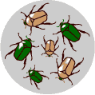
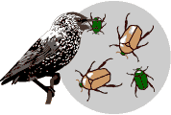
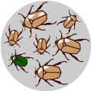
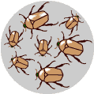
Example of Natural Selection
There is variation in traits. For example, some beetles are green and some are brown.
There is differential reproduction. Since the environment can't support unlimited population growth, not all individuals get to reproduce to their full potential. In this example, green beetles tend to get eaten by birds and survive to reproduce less often than brown beetles do.
There is heredity. The surviving brown beetles have brown baby beetles because this trait has a genetic basis.
End result: The more advantageous trait, brown coloration, which allows the beetle to have more offspring, becomes more common in the population. If this process continues, eventually, all individuals in the population will be brown.
http://evolution.berkeley.edu/evolibrary/article/evo_25

Slide 4
Natural Selection
Important traits in natural selection- disease resistance, size, color pattern / camouflage, etc…
Types of natural selection:
Stabilizing selection- individuals with the average or norm for a trait have an advantage over other forms of the trait. (gray moths are favored over black and white moths)
Directional selection- individuals with one extreme or less common version of a trait are favored over other forms of the trait. (black moths are favored over gray or white moths)
Disruptive selection- multiple extremes or alternative forms of a trait are formed over the norm. (black moths and white moths are favored over gray moths)

Slide 5
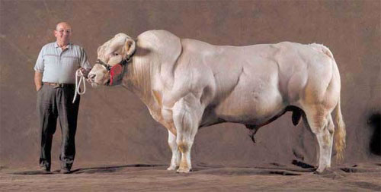
Selective Breeding
Method of breeding plants and animals utilized in agriscience to produce offspring that possess certain characteristics desirable to agriculturalists.
Utilized for generations- produced the first domestic animals in early civilizations.

Slide 6
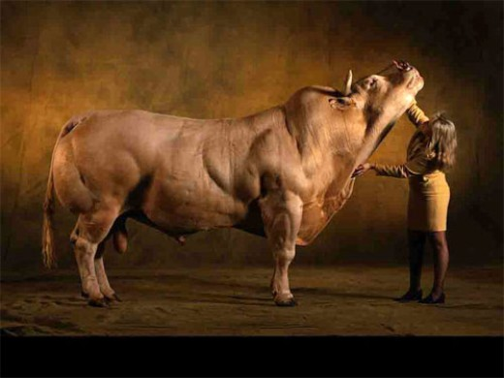
Selective Breeding
Used to select for a variety of traits including:
Muscling / Size
Fat Content
Breeding capability
Color
Speed / Agility
Temperament
Milk Production

Slide 7
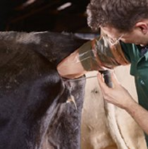
Selective Breeding
Methods for selective breeding
Artificial insemination
Pen/field breeding
Isolation breeding-inbreeding
Mechanical pollination of plants
Hybridization of plants and animals

Slide 8
Selective Breeding
Selective breeding is accomplished much quicker in plants than animals due to growth rates and ease of propagation/production

Slide 9
DNA and Genetics in Biotechnology
Objective 14.02: Evaluate animal and plant specimens for breeding potential based on phenotypic and genotypic value.

Slide 10
Guidelines for selecting Plant and Animal Specimens for Breeding
Observe patterns of heredity
The occurrence of genetic disorders in offspring or parents is an indicator that the parent may have a recessive gene for the disorder.
Though genetic recombination is random, some animals are more likely to transmit genes than others- keeping careful breeding records improves effectiveness.

Slide 11
Guidelines for selecting Plant and Animal Specimens fro Breeding
Select animals carefully- besides a good genetic background, animals used in selective breeding programs should be:
Healthy- old injuries or illnesses are not a factor unless they are a result of genetic propensities or impair breeding capabilities.
Carefully monitored- nutrition levels, pests, and stress can all reduce breeding viability. Some very good specimens are completely isolated.
Hybrids should be AVOIDED, since traits expressed in the organism are rarely transmitted to offspring.
The process of inbreeding isolates genes for only a single generation, as many are recessive.

Slide 12
Guidelines for selecting Plant and Animal Specimens fro Breeding
Carefully plan breeding crosses
Plants can be crossed not only within species (interspecific), but also within genus (intergeneric), and even, in rare cases family (interfamilial).
Animals are usually limited to crosses within the same species.

Slide 13
Methods for Producing Selective Breeding Programs
1. Inbreeding- crossing organisms that are genetically related.
Crossing two plants to produce an f 1 generation, then crossing two of the f 1 offspring to create an f2 generation.
2. Backcrossing- crossing offspring from a cross with one of the previous parents, or a similar organism, to maximize the expression of certain traits.
Often used after intergeneric crosses to produce offspring that possess more characteristics from one of genus.

Slide 14
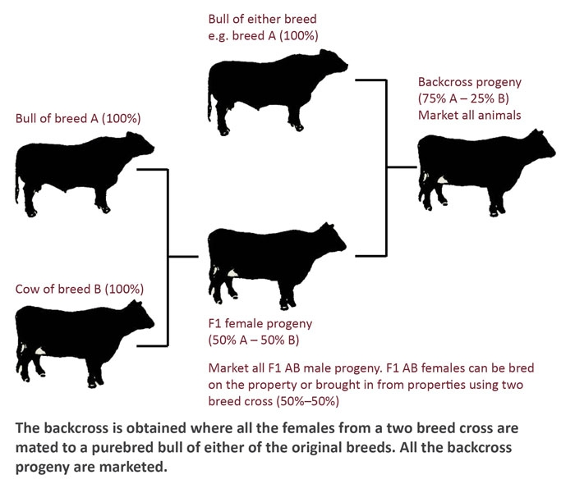

Slide 15
DNA and Genetics in Biotechnology
Objective 15.01: Identify methods and goals of DNA analysis in production agriculture and agriscience.

Slide 16
Methods of DNA Analysis
1. Paternity Testing
a. Simple method of DNA analysis that compares the DNA of an offspring, plant or animal with a known mother and suspected father.
b. Process:
i) DNA sample taken usually from saliva or blood in animals and leaf or callus tissue in plants. (Hair does not contain DNA, but the hair follicle does.)
ii) DNA isolated in sample through the use of protein “eating” enzymes.
iii) Sample run on gels or through a gene sequencer to indicate the presence of certain genes.
iv) Comparison of genes - anything present in the child MUST BE PRESENT IN EITHER THE MOTHER OR FATHER. 13 genes present in the child that are not in the mother, but present in the father make a 99% match.

Slide 17
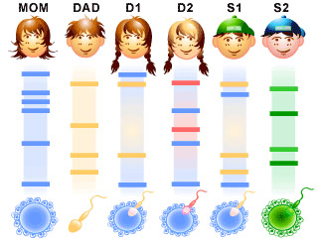
Methods of DNA Analysis
1. Paternity Testing

Slide 18
Methods of DNA Analysis
2. Gel Electrophoresis
a. Method used to analyze extracted DNA through the distribution of genetic markers on an agar media.
b. Process:
i) An agar gel is poured into a mold to dry, then placed into a electrophoresis chamber.
ii) DNA extraction is placed in small wells at one end of the agar gel. Each well represents a different sample or individual.
iii) Electric current is run through the wells, distributing DNA across the gel.
c. Smaller gene segments travel further distances on the gel. Samples extracted through the same process can be easily compared on a single gel.

Slide 19
Methods of DNA Analysis
3. Advanced Methods of DNA Analysis
a. Polymer Chain Reaction (PCR)
i) Method used in forensic science to amplify genetic material for identification or analysis.
ii) Newer technique used only in advanced laboratories.
b. Amniocentesis- method used to analyze the DNA of a mammal (occasionally other animals) prior to birth.
i) Used widely in humans to predict the expression of lethal genes or genetic disorders in high-risk pregnancies.
ii) Gaining favor in high expense animal breeding- (race horses, etc.)

Slide 20
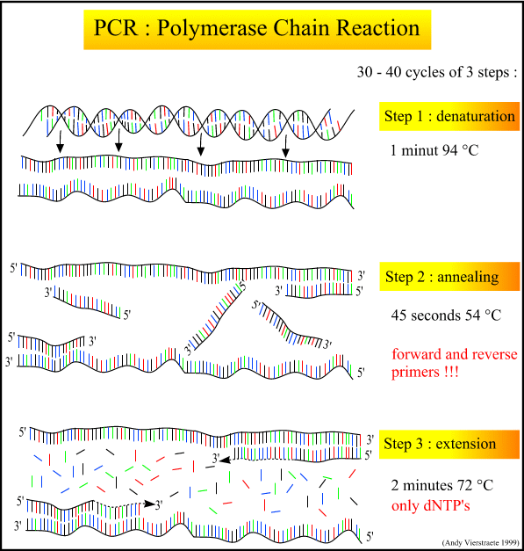
PCR

Slide 21
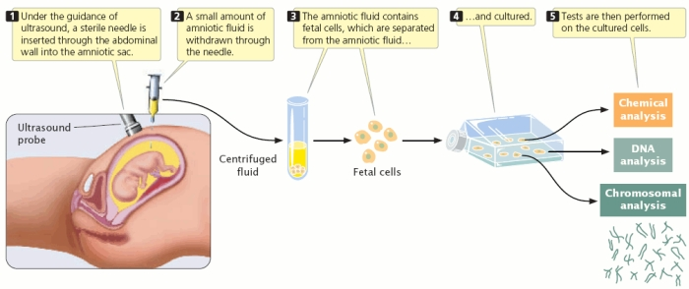
Amniocentesis

Slide 22
DNA and Genetics in Biotechnology
Objective 15.02: Explore the process of DNA extraction in order to observe the structure of DNA.

Slide 23
General DNA Extraction
1. DNA Extraction- the process of isolating nucleic acids (DNA) from organic material.
2. DNA can be extracted from almost any intact cellular tissue. More cells make extraction easier, but only a few cells are need with PCR techniques.
a. Skin, blood, saliva, semen, mucus, muscle tissue, bone marrow, etc.
b. DNA cannot be extracted from hair, unless skin is attached at the bottom.

Slide 24
General DNA Extraction
3. Mitochondrial DNA can often be extracted long after nuclear DNA has degraded.
Mitochondria are structures within cells that convert the energy from food into a form that cells can use. Although most DNA is packaged in chromosomes within the nucleus, mitochondria also have a small amount of their own DNA. This genetic material is known as mitochondrial DNA or mtDNA. In humans, mitochondrial DNA spans about 16,500 DNA building blocks (base pairs), representing a small fraction of the total DNA in cells.

Slide 25
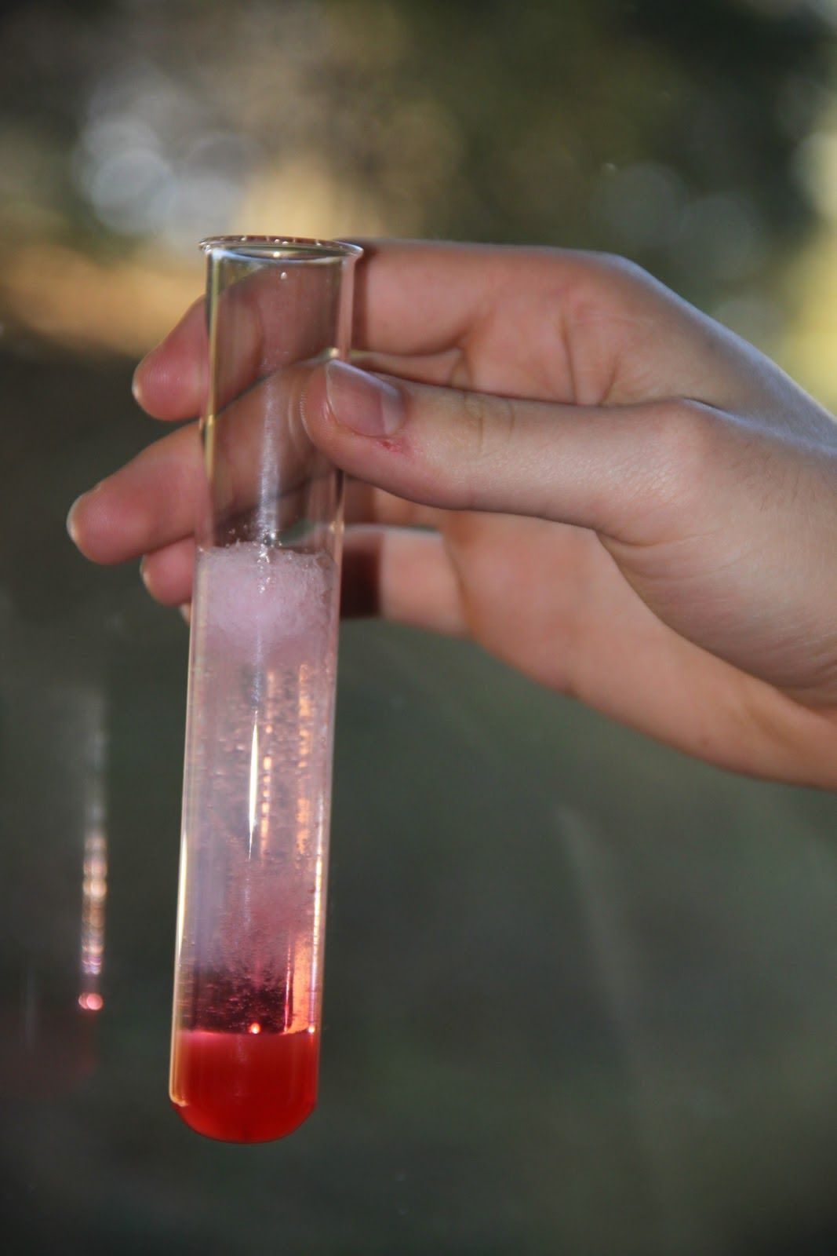
General DNA Extraction
4. A simple DNA extraction for viewing, but not analyzing DNA can be accomplished by:
a. Physically breaking apart plant material, usually fruits. (smashing up a strawberry)
b. Use of a detergent to break apart the cell membrane.
c. Treatment with ethyl alcohol to isolate DNA from remaining proteins and sugars. (extraction for analysis would use enzymes)
d. Spooling using a glass rod to view a large clump of nucleic acids (DNA).

Slide 26
DNA Extraction Process
1. The organism to be tested is chosen, and a sample is taken from which DNA can be extracted.
2. Detergents are used in simple DNA extraction procedures to break down cell membranes, blending the contents of the cell.
3. The DNA sample is treated with enzymes to isolate nucleic acids, usually both DNA and RNA.
a. Enzymes dissolve proteins, sugars, and other materials.
b. Ex: protease, amylase, etc (enzymes end with the suffix- ase)
4. A second enzyme may be applied to cut DNA into gene segments for analysis.

Slide 27
DNA and Genetics in Biotechnology
Objective 15.03: Interpret a written protocol for restriction digest and gel electrophoresis.

Slide 28
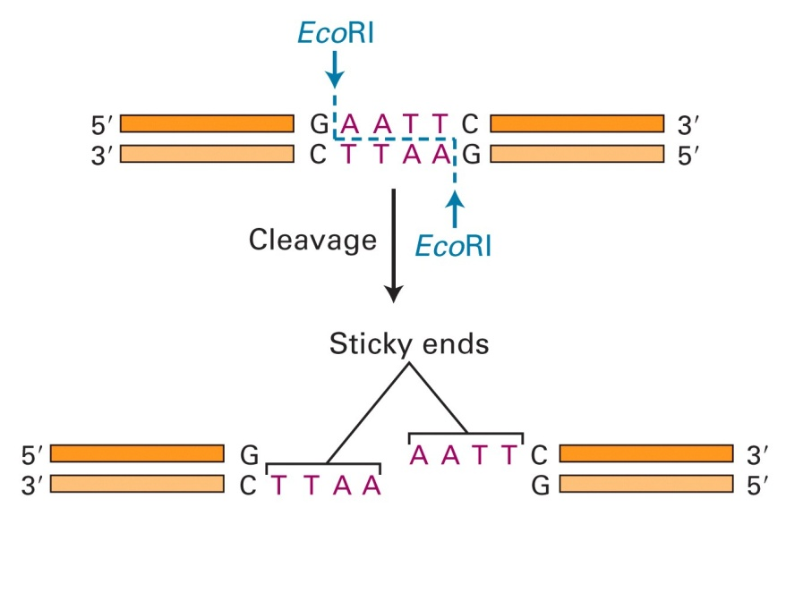
Restriction Digests and Enzyme Properties
1. Restriction enzymes are used to cut extracted DNA into smaller gene sequences.
a. Makes analysis easier during the process of gel electrophoresis.
b. Enables scientists to isolate specific genes with specific enzymes for use in genetic engineering.
2. Cuts the gene from the chromosome making a sort of gene soup after the removal of proteins.
3. Leave the ends of gene segments with “sticky” with usually 3 exposed nucleotides on one side of the double helix, so that ends may be rejoined later.

Slide 29
Gel Electrophoresis
1. Low voltage direct current run through a buffer solution surrounding an agar gel distributing DNA fragments across the gel.
a. Fragments separated by the size of the gene segment; smaller move faster than larger.
b. Negative charged DNA fragments are repelled away from the negatively charged wells to the positive charged end.
2. Buffer solution provides a means of transmission for electrical current, but also KEEPS DNA SAMPLES IN PLACE IN WELLS IN THE GEL.
a. Buffer is heavier than DNA.
3. Strength of the electrical current determines the speed at which DNA moves across the gel.
4. Ethidium Bromide or another Bromine based solution is applied at the end of the electrophoresis process to stain DNA for better viewing under certain bands of light.

