Slide 1
Forestry Tools I.D.

Slide 2
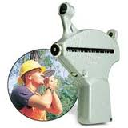
Altimeter

Slide 3
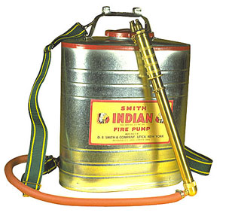
Back-Pack Fire Pump

Slide 4
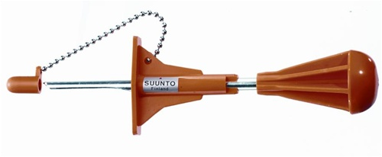
Bark Gauge

Slide 5
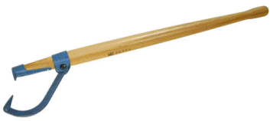
Canthook

Slide 6
Chainsaw

Slide 7
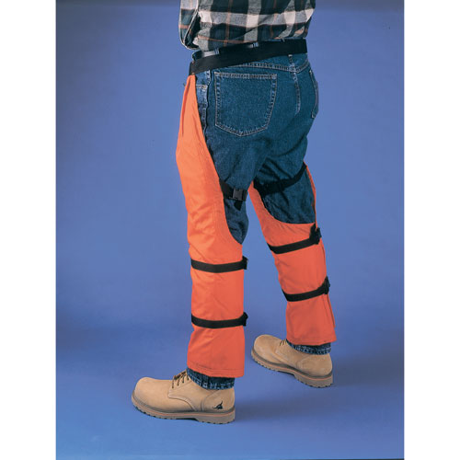
Chainsaw Chaps

Slide 8
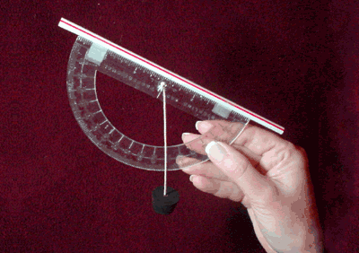
Clinometer

Slide 9
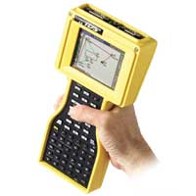
Data Recorder

Slide 10
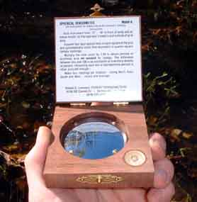
Densiometer

Slide 11
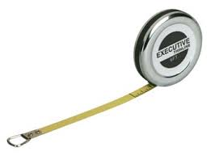
Diameter Tape

Slide 12
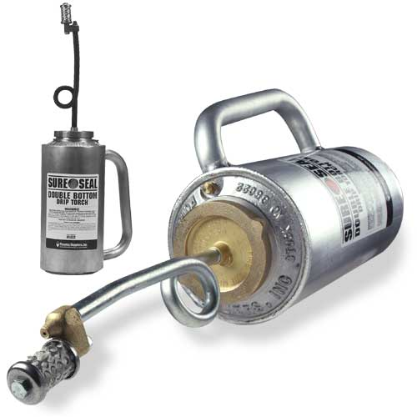
Drip Torch

Slide 13
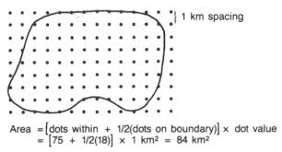
Dot Grid

Slide 14
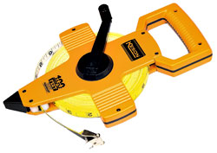
Fiberglass Measuring Tape

Slide 15
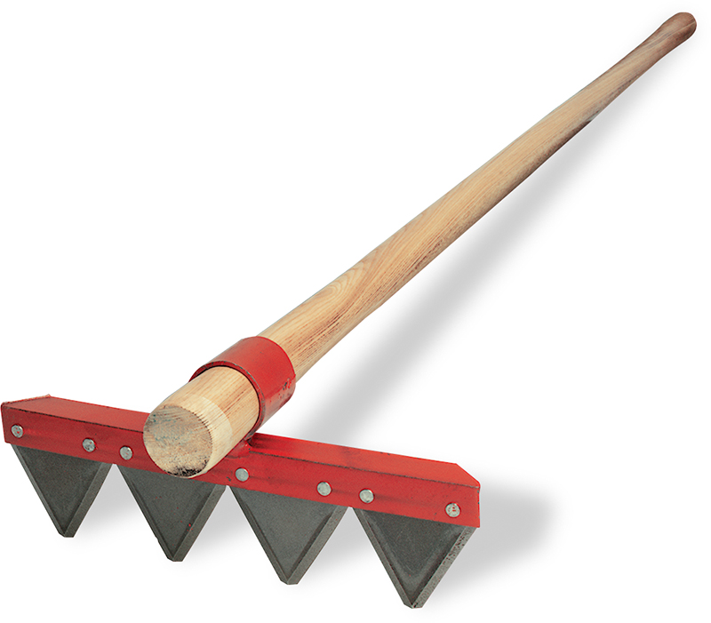
Fire Rake

Slide 16
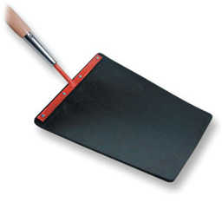
Fire-Swatter

Slide 17
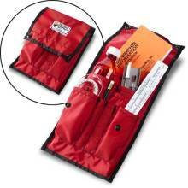
Fire Weather Kit

Slide 18
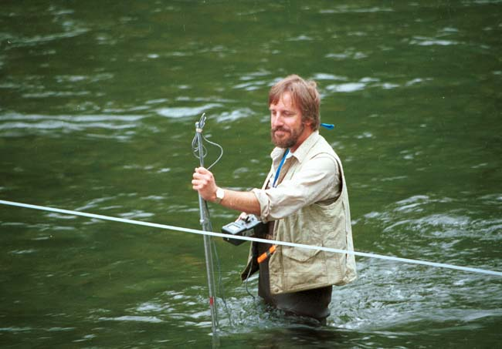
Flow/current Meter

Slide 19
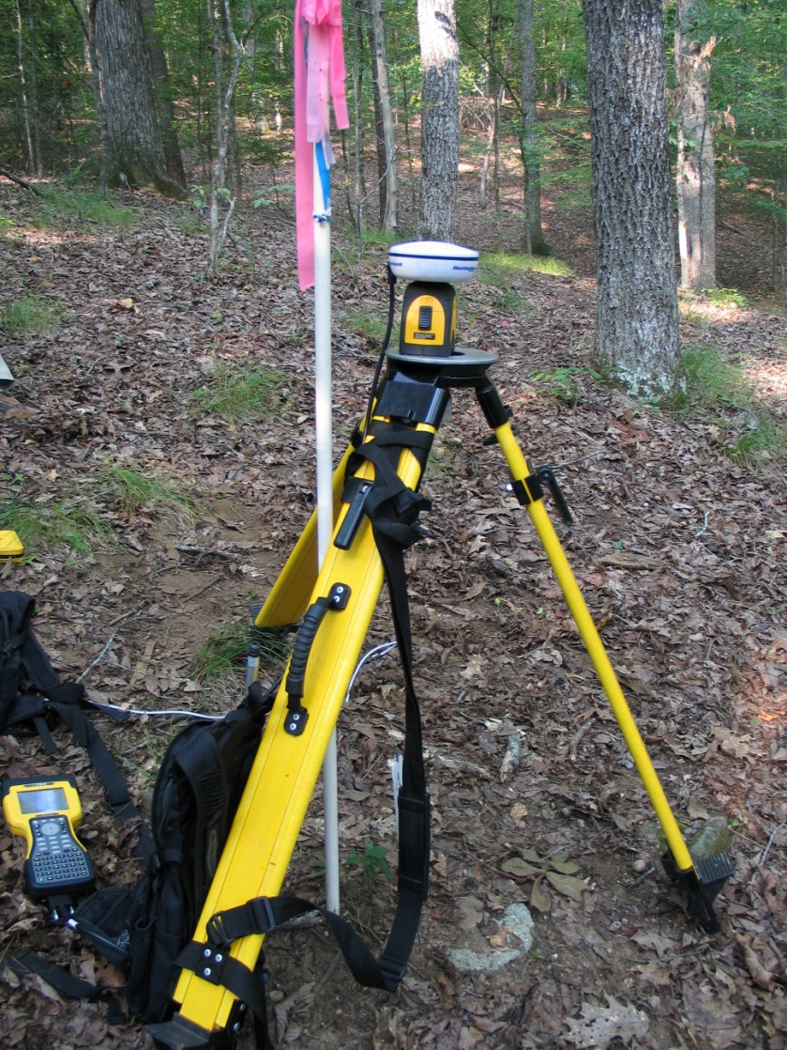
GPS Reciever

Slide 20
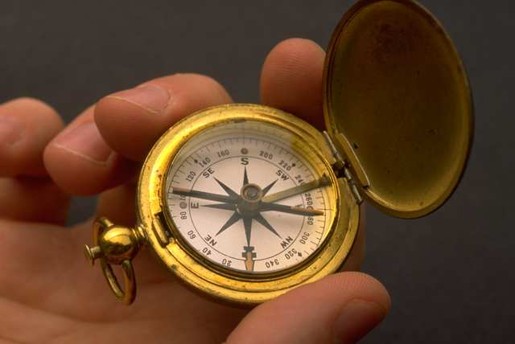
Hand Compass

Slide 21
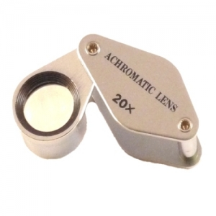
Hand Lens/Field Microscope

Slide 22
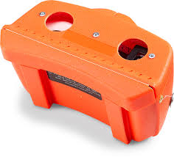
Hip Chain

Slide 23
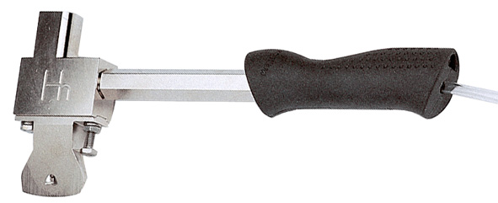
Hypo-Hatchet

Slide 24
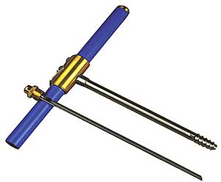
Increment Borer

Slide 25
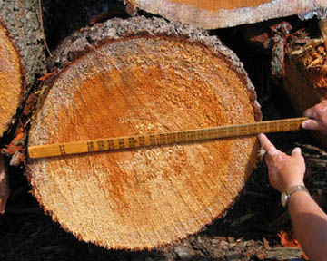
Log Rule

Slide 26
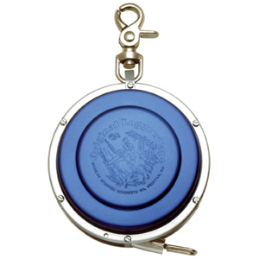
Logger’s Tape

Slide 27
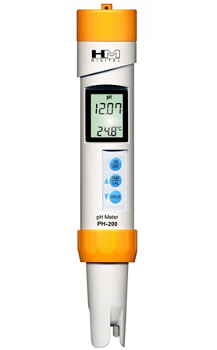
pH Meter

Slide 28
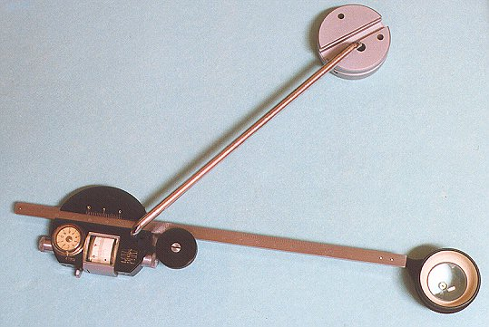
Planimeter

Slide 29
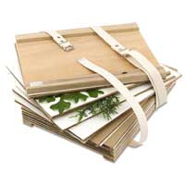
Plant Press

Slide 30
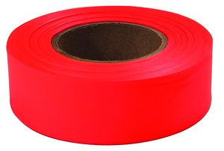
Plastic Flaggin

Slide 31
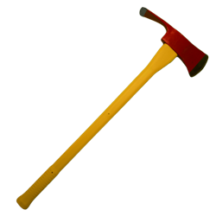
Pulaski Forester Axe

Slide 32
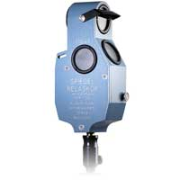
Relaskop

Slide 33
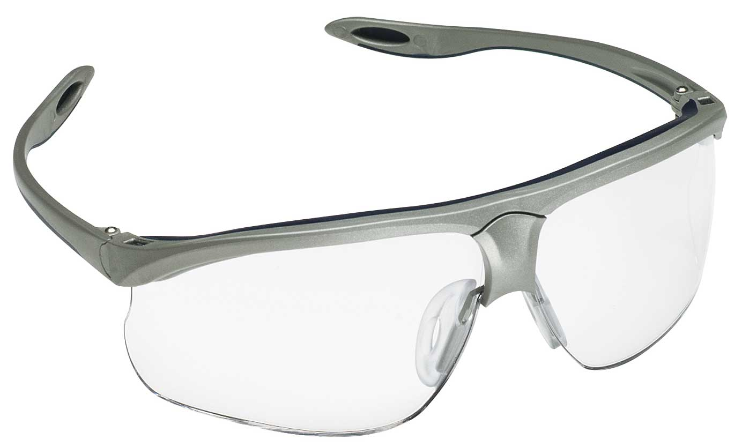
Safety Glasses

Slide 34
Safety Hard Hat

Slide 35
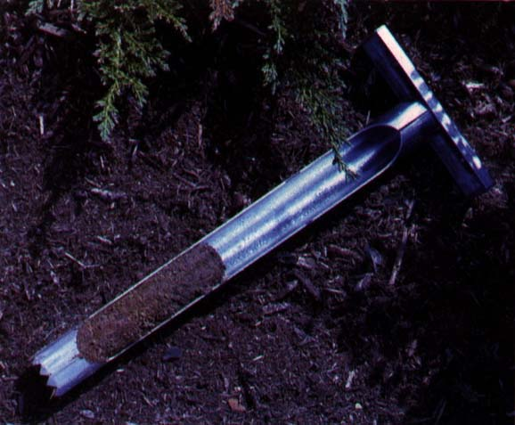
Soil Sampler

Slide 36
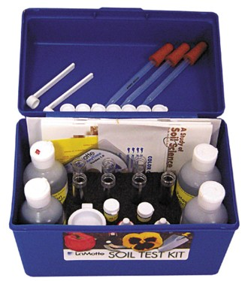
Soil Test Kit

Slide 37
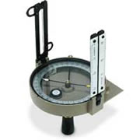
Staff Compass

Slide 38
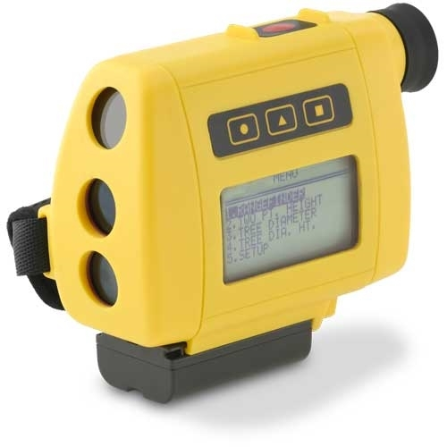
Stereoscope

Slide 39
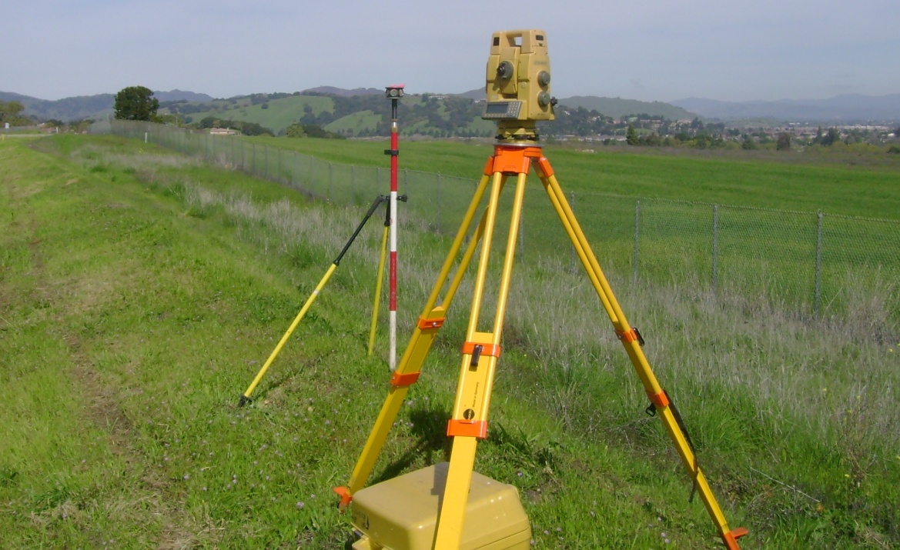
Survey Instrument

Slide 40
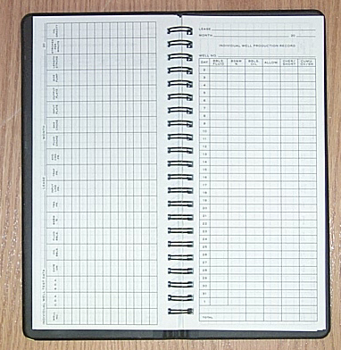
Tally Book

Slide 41
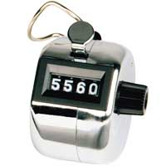
Tally Meter

Slide 42
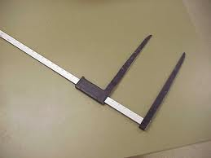
Tree Caliper

Slide 43
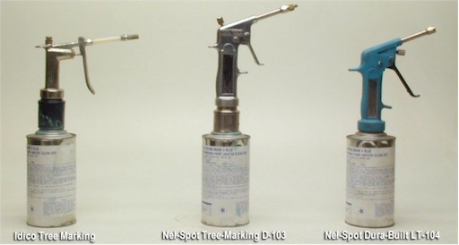
Tree Marking Gun

Slide 44
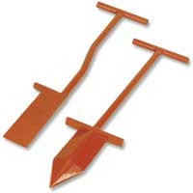
Tree Planting Hoe

Slide 45
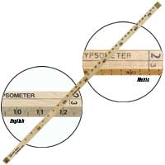
Tree Stick

Slide 46
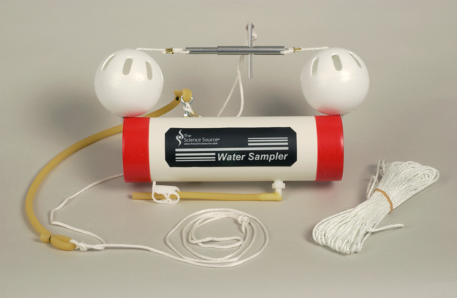
Water Sampler

Slide 47
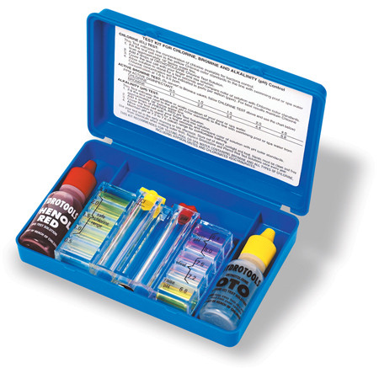
Water Test Kit

Slide 48
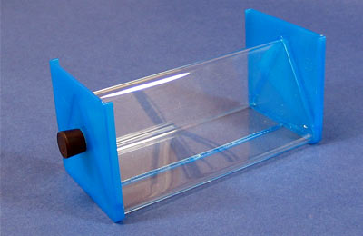
Wedge Prism

Slide 49
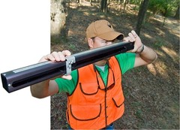
Wheeler Caliper

