Slide 1
Introduction to the FFA
Mr. Carscaddon

Slide 2
“True contentment is a thing as active as agriculture. It is the power of getting out of any situation all that there is in it. It is arduous and it is rare.” G. K. Chesterton
Summarize quote then answer:
What is true contentment?
What does this quote say about agriculture?
Are you truly content?
What would it take for you to be truly content?

Slide 3
Today’s Agenda
Mission
Vision
Structure
Creed

Slide 4
FFA State Convention
http://www.youtube.com/watch?v=XMeEHlNMdSY&safety_mode=true&persist_safety_mode=1&safe=active
Notes:
http://www.youtube.com/watch?v=XMeEHlNMdSY&safety_mode=true&persist_safety_mode=1&safe=active

Slide 5
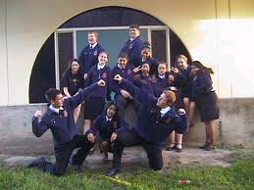
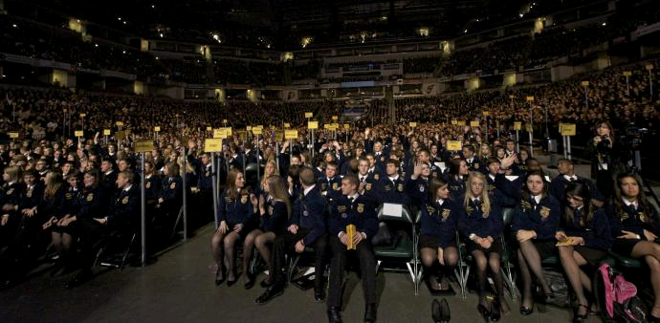
What is FFA?

Slide 6
FFA
A national organization for students enrolled in agricultural classes.

Slide 7
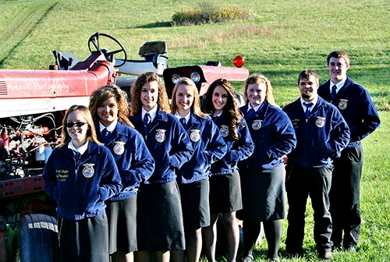
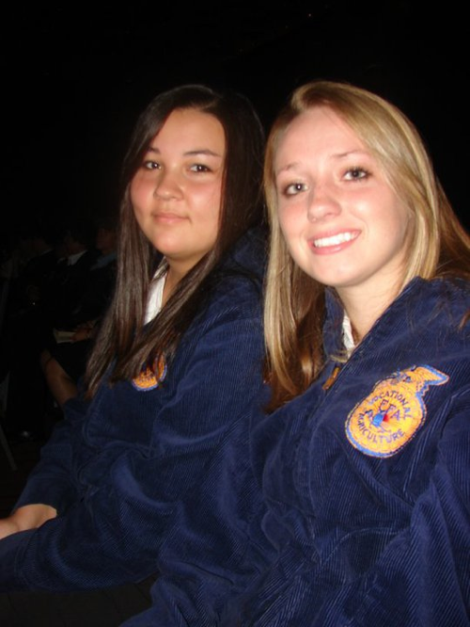
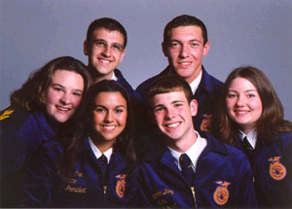
FFA is all about YOU!

Slide 8
The FFA Motto
Learning to Do
Doing to Learn
Earning to Live
Living to Serve

Slide 9
Mission
FFA makes a positive difference in the lives of students by developing their potential for:
Premier leadership
Personal Growth
Career success

Slide 10
Premier Leadership

Slide 11
Premier Leadership
Opportunities to lead yourself as well as others.
Promotes cooperation and cooperative attitudes.
Builds character, promotes citizenship, and volunteerism

Slide 12
Personal Growth

Slide 13
Personal Growth
Strengthening students confidence in themselves and their work
Develops interpersonal skills in teamwork, communication, human and social interaction
Encourage excellence in scholarship

Slide 14
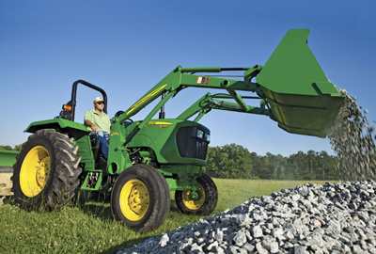
Career Success

Slide 15
Career Success
Encourages the intelligent choice and establishment of an agricultural career
Increases awareness of global and technological importance of agriculture
The management of economic, environmental, and human resources
Remember 20% of the economy is in agriculture, with jobs increasing for college graduates

Slide 16
Vision
The National FFA Origination envisions a future in which all agricultural education students will discover their passion in life and build on that insight to chart the course for their educational, career, and personal future.

Slide 17
Structure of the FFA

Slide 18
National FFA
North Carolina FFA Association
Regions
Federation
Chapter

Slide 19
Creed
Written by E. M. Tiffany and adopted at the 3rd national convention.
Leads, guides, and units all people involved in agricultural education.

Slide 20
Reasons to memorize creed
Learn Public Speaking Skills
Builds self confidence
Emphasizes personal growth

Slide 21
Creed 1st Paragraph
I believe in the future of agriculture, with a faith born not of words but of deeds-achievements won by the present and past generations of agriculturists; in the promise of better days through better ways, even as the better things we now enjoy have come to us from the struggles of former years.

Slide 22
Me Poster
Purpose: Visual representation of yourself
Draw yourself
Draw/bring in pictures describing activities you enjoy
Describe yourself with 5-6 adjectives
Why did you choose these words? Why do they describe you specifically?
Describe your family/friends
What in your life is related to agriculture?

Slide 23
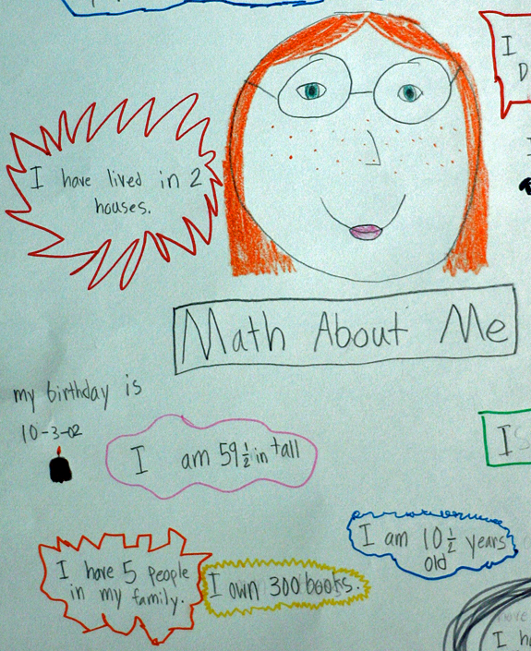
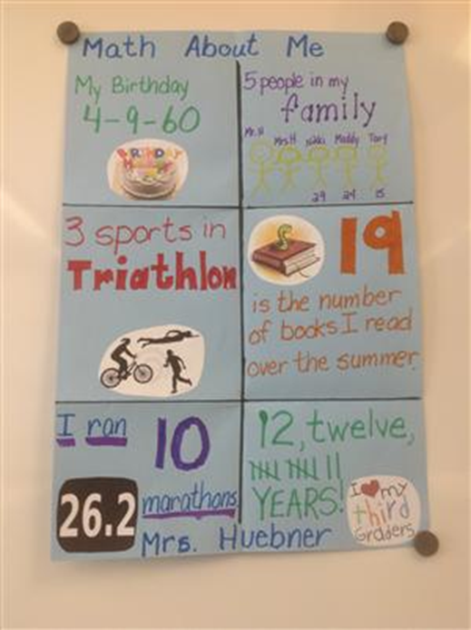
Me Poster
3-5 minute speech

Slide 24
Public Speaking
Voice
Stage Presence
Stance/ Hands
Content/ Memorization

Slide 25
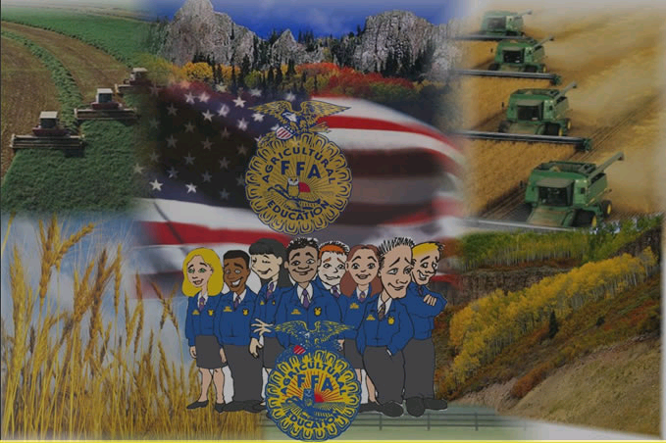

Slide 26
Exit Ticket
1. What are the 3 main parts of the FFA Mission?
2. Who can join the FFA?
3. Who wrote the Creed?

Slide 27
Works Cited
http://www.monsantoblog.com/wp-content/uploads/2011/11/FFA-Jacket-Emblem.jpg
http://www.ndffa.org/Images/FFA%20Image.png
ffanationalofficers.blogspot.com
http://www.ed.gov/sites/default/files/imagecache/node-gallery-display/ffa-great-state-of-indiana-5.jpg
http://www.whiteville.k12.nc.us/groups/ashleyfowler/wiki/8e0ff/images/__thumbs__/b1d78.jpg
http://www.rocori.k12.mn.us/activities/ffa/Images/FFA%203.jpg
http://www.waynet.org/nonprofit/ffa/2011-2012ffa.jpg

