Slide 1
Mind Warmer
When composing oral reasons what are the different pairs that you compare?

Slide 2
Board Warmer
Write and answer questions:
What do you think of when you here the word Agriculture?
What about Animal Science?
How have you interacted with Agriculture and Animal Science today?

Slide 3
Board Warmer
Write Questions then answer:
What is a barrow?
What breed of swine is mostly black with a white belt around the front legs?
What is a pullet?
Which breed is common for layers and which is for broilers?

Slide 4
Animal Science 1

Slide 5
Introduction
Competency: 001.00 Investigate agricultural animals in order to build a foundational knowledge for advanced animal science studies
Objective: 001.01 Define terms used to distinguish animals by sex, age and physical traits in the beef, swine and poultry industry.

Slide 6
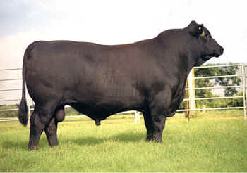
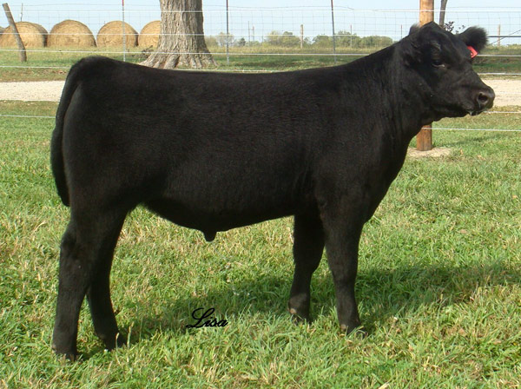
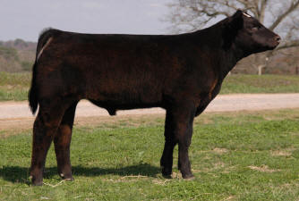
Terminology for Cattle
Bull –
Non-castrated male bovine
Steer –
Castrated young male bovine
Stag –
Castrated old male bovine

Slide 7
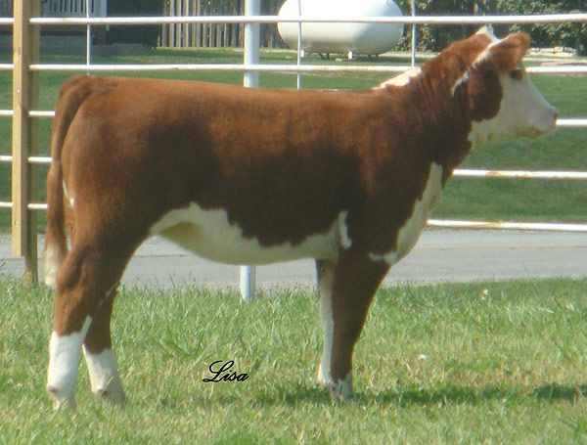
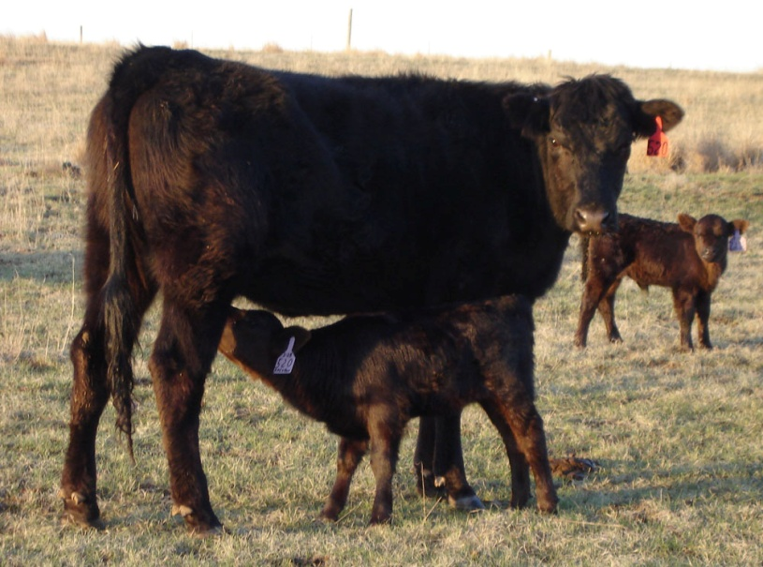
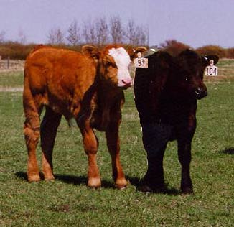
Terminology for Cattle
Heifer –
Young female that has not given birth
Cow –
Older female that has given birth
Calf –
Baby bovine

Slide 8
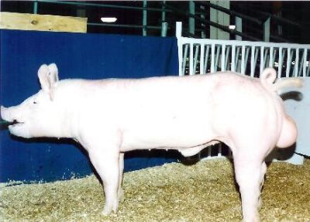
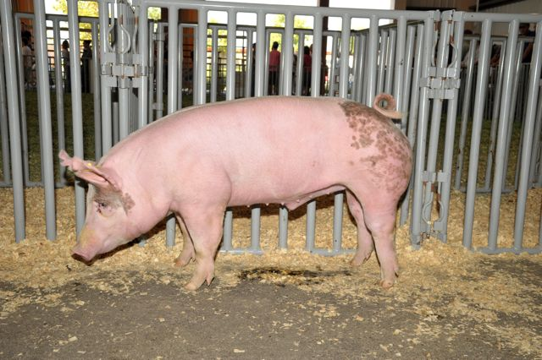
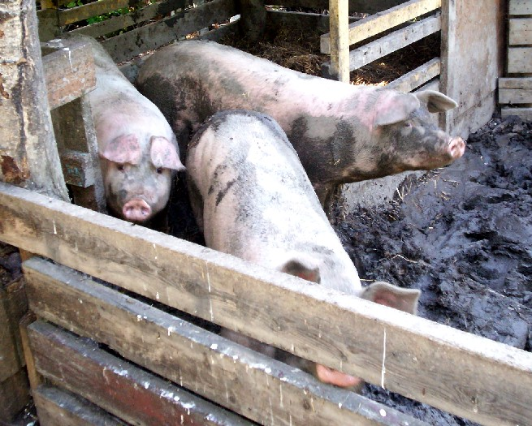
Terminology for Swine
Boar-
male that has not been castrated
Barrow-
castrated young male swine
Stag-
male castrated after reaching maturity

Slide 9
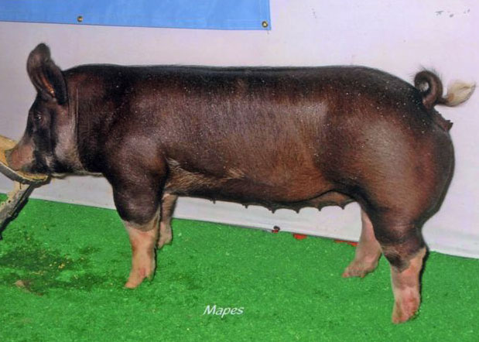
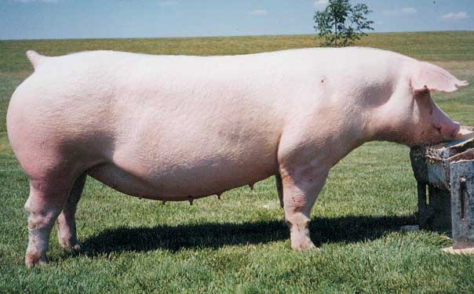
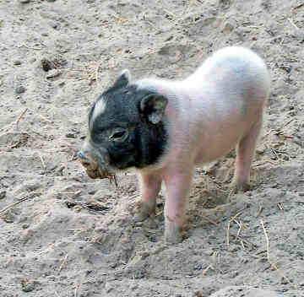
Terminology for Swine
Gilt –
Young female that has not given birth
Sow –
Older female that has given birth
Pig –
Baby swine

Slide 10
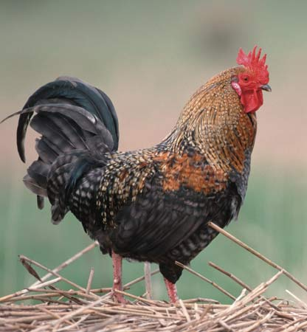
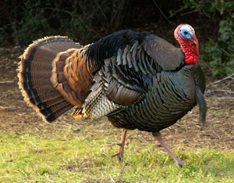
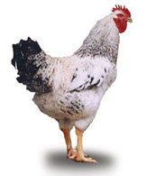
Terminology for Poultry
Rooster –
Male chicken that has not been castrated
Tom –
Male turkey that has not been castrated
Capon –
Male castrated when young

