Slide 1
Board Warmer
Write our objectives today:
What are the different parts of poultry?
What are the different breeds?
How are layers and broilers produced?
Which came first, the chicken or the egg?

Slide 2
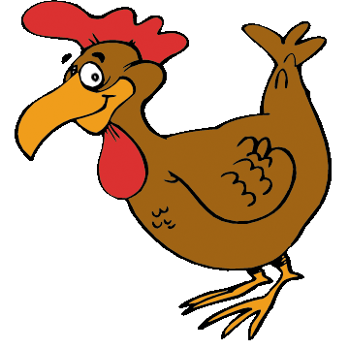
Poultry 101
Cleveland High School
CVHS Animal Science 1

Slide 3
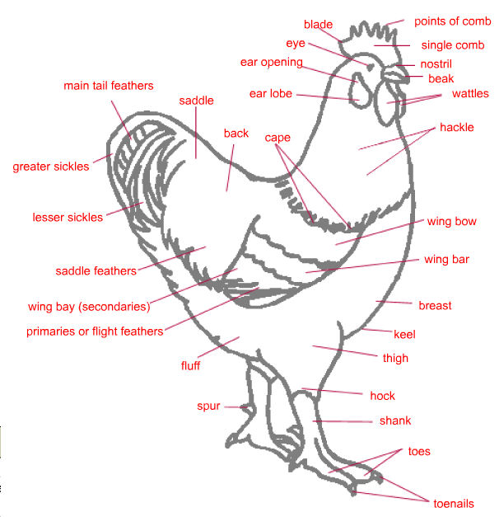
`
CVHS Animal Science 1
Notes:
http://www.youtube.com/watch?v=7J4aK5uAYWI

Slide 4
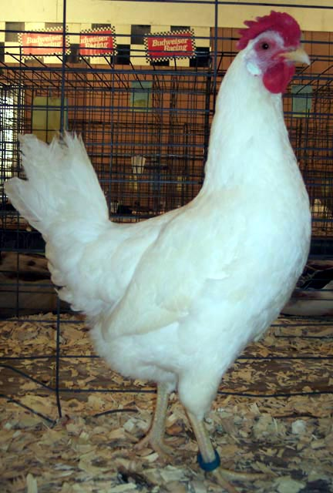
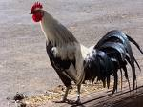
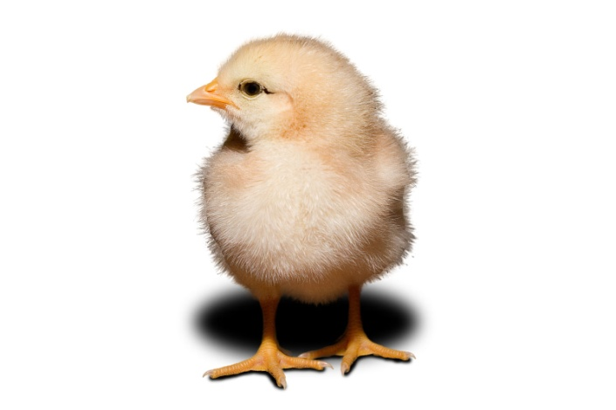
Terminology for Poultry
Cock( Rooster) – Adult male chicken
Hen– Adult female chicken
Chick – Newborn chicken
CVHS Animal Science 1

Slide 5
Terminology for Poultry
Capon – Castrated male chicken between 14-17 weeks of age
Cockrel – Immature male chicken
Pullet – Immature female chicken
CVHS Animal Science 1

Slide 6
Introduction
Two basic types of Poultry Enterprises:
  Broiller – Used mainly for meat.
  Layer – Used mainly for egg production.
CVHS Animal Science 1

Slide 7
Common Breeds of Poultry
CVHS Animal Science 1

Slide 8
Poultry Breeds
White Leghorn
  White in color
  Smaller in size
  Lays white eggs
  Used for layers
CVHS Animal Science 1

Slide 9
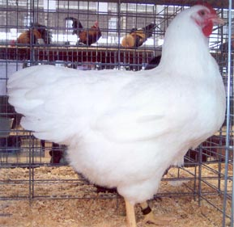
Poultry Breeds
Plymouth Rock
  White in color
  Larger birds
  Used as broilers
CVHS Animal Science 1

Slide 10
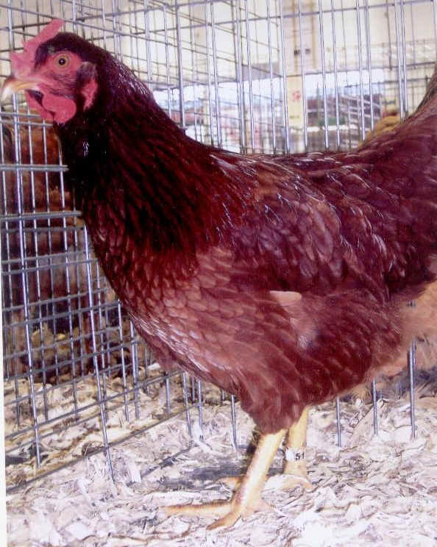
Duel Breeds
Rhode Island Red
  Red color
  Lays Brown Eggs
CVHS Animal Science 1

Slide 11
Poultry Production in NC
– Broilers –
CVHS Animal Science 1

Slide 12
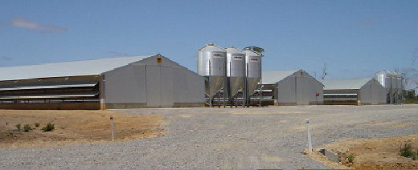
Broiler Production
Broilers are grown on the floor of large “Broiler Houses.” Each house can hold over 100,000 birds.
CVHS Animal Science 1

Slide 13
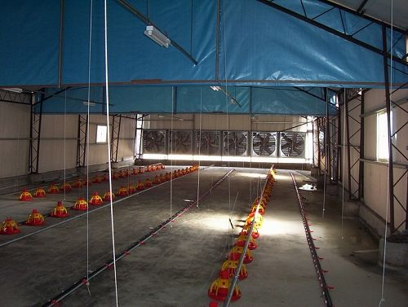
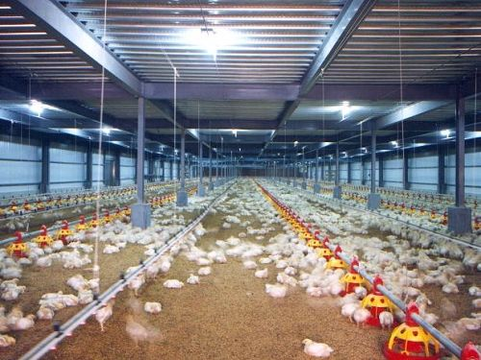
CVHS Animal Science 1

Slide 14
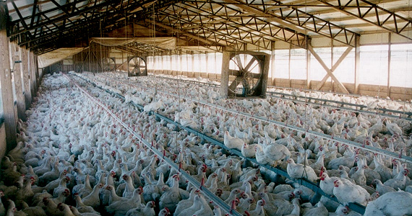
Broiler Production
CVHS Animal Science 1

Slide 15
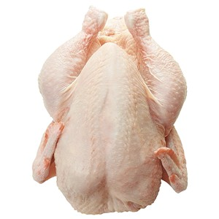
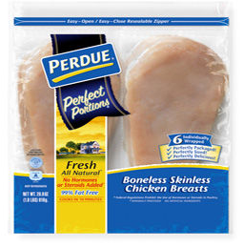
Broiler Production
Broilers will reach market weight and maturity in about 9 weeks.
They will be between 3 and 5 lbs in weight.
They will be used for whole fryers or cut into parts or specialty cuts for the grocery store.
CVHS Animal Science 1

Slide 16



Broiler Production
Almost 99% of all Broilers grown in the US are grown on Vertical Integration systems.
Vertical Integration is when two or more steps of production, marketing or processing are linked.
CVHS Animal Science 1

Slide 17
Broiler Production
Vertical Integration is like contract growing:
The grower signs a contract in which:
The grower provides the house, and is guaranteed a price for each bird produced.
The producer provides everything else to the grower.
CVHS Animal Science 1

Slide 18
Poultry Production in NC
– Layers –
CVHS Animal Science 1

Slide 19
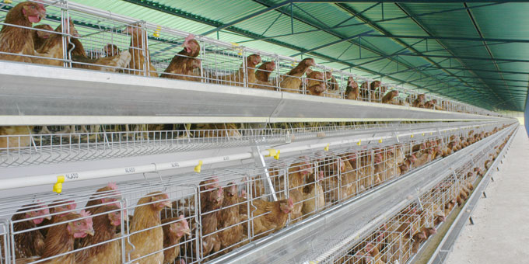
Layers
Layers are kept in “layer cages” in large open barns.
CVHS Animal Science 1

Slide 20
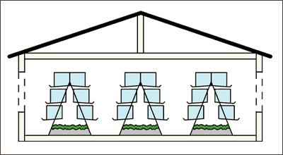
Layers
The cages are often stacked on top of each other to increase the number of layers in an area
CVHS Animal Science 1

Slide 21
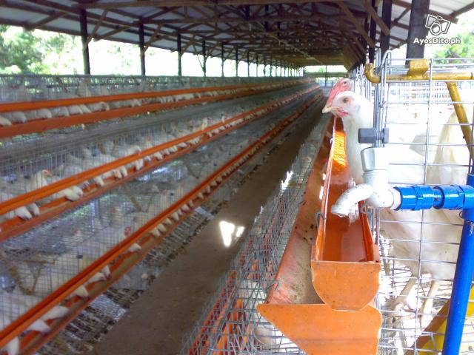
Layers
The cages are tilted so that eggs will collect at the front of the cage and then can be transported to a collection area
CVHS Animal Science 1

Slide 22
Layers begin producing eggs at 21 weeks of age, then they will produce an average of an egg a day for the first year.
They next go through a molting period for approximately 3 months in which they will stop producing eggs and produce new feathers.
Artificial light is used to increase the laying ability of the birds
CVHS Animal Science 1

Slide 23
The collected eggs are unfertilized and must be refrigerated within 5 hours to ensure freshness.
The eggs are weighed, inspected and candled to determine quality.
CVHS Animal Science 1

Slide 24
Quality Factors
Confirmations – ideal is normal breastbone, back, legs and wings
Fleshing – well fleshed or muscled is ideal
Fat covering – well covered is ideal
CVHS Animal Science 1

Slide 25
Quality Factors
Exposed flesh – none is ideal, to grade A – breast and legs cannot have more than
1/4" exposed flesh (under 6 lb. carcass) from cuts, tears. Other parts such as back and wings can have from 1” to 3” depending on weight of carcass with larger carcasses able to have more and still be grade A
CVHS Animal Science 1

Slide 26
Quality Factors
Discolorations – from bruises not allowed on breast and legs of grade A, some from other causes allowed.
Disjointed and broken bones – no broken and one disjointed allowed for grade A.
Missing parts – wing tips and tail can be missing on grade A
Freezing defects – slight ones allowed for grade A.
CVHS Animal Science 1

Slide 27
USDA Ready-to Cook Poultry Grade
A, B, C, No Grade – from best to worst
Ready-to cook means the head, feet feathers, blood and viscera (soft internal parts) have been removed.
USDA Grades indicate quality, NOT sanitation
CVHS Animal Science 1

Slide 28
THE END
Any questions?
CVHS Animal Science 1

