Slide 1
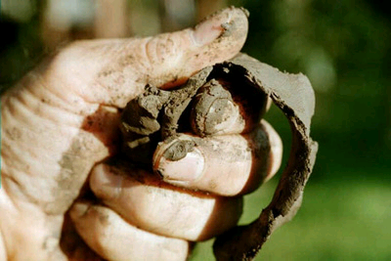
Ribbon Test

Slide 2
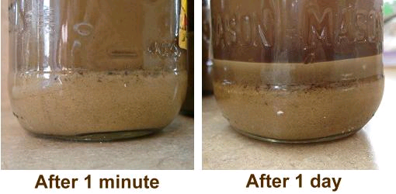
Jar Test

Slide 3
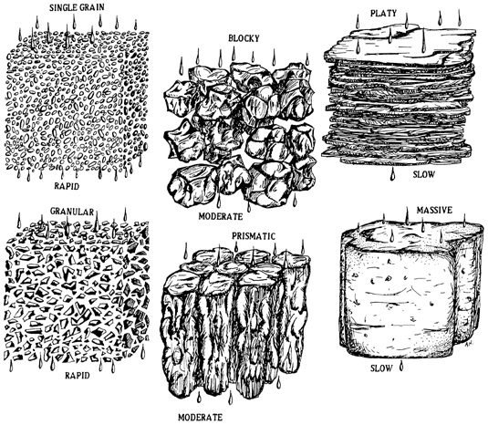
Soil Structure: Arrangement
Structureless
Blocky
Platy
Granular
Prism-Like

Slide 4
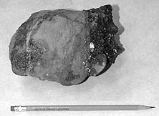
Soil Structure: Structureless
Structureless
Single grained
Massive
Examples: Sand or hard packed clay

Slide 5
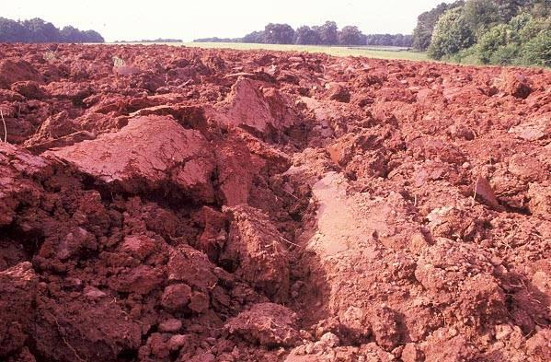
Soil structure: Blocky
Blocky
Angular
Subangular
Examples: Clay

Slide 6
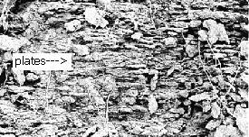
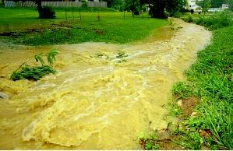
Soil Structure: Platy
Platy
Examples: Silt that has built up beside riverbanks.

Slide 7
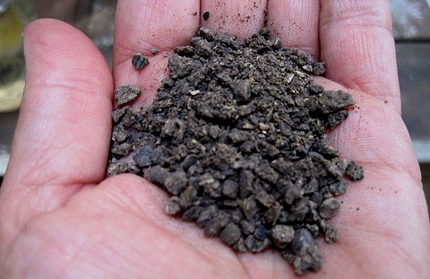
Soil Structure: Granular
Granular
Spherical
Example: Silt and clay mix

Slide 8
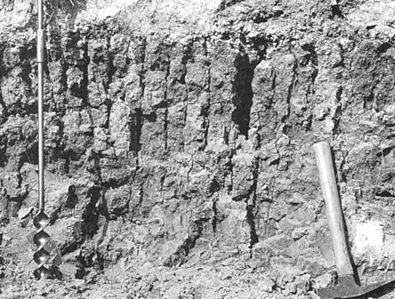
Soil Structure: Prism-Like
Prism-Like
Prismatic
Columnar
Example: Clay or silt that’s on level ground.

Slide 9
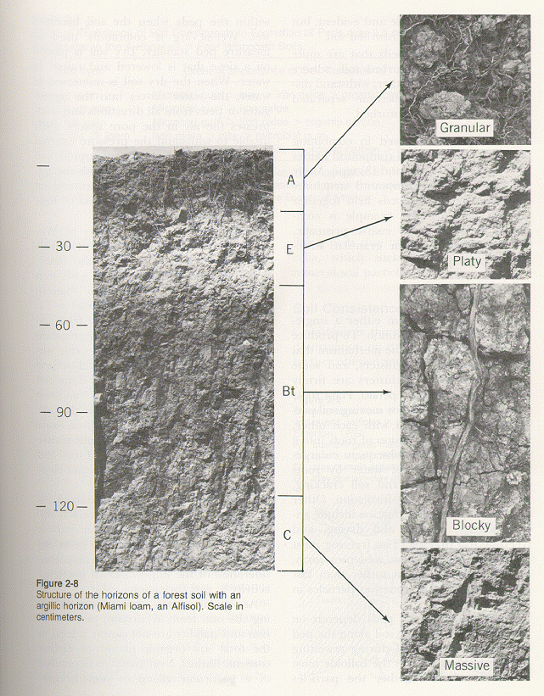
Degrees of expression
Structureless
(The weakest expression)
Weak
Moderate
Strong

Slide 10
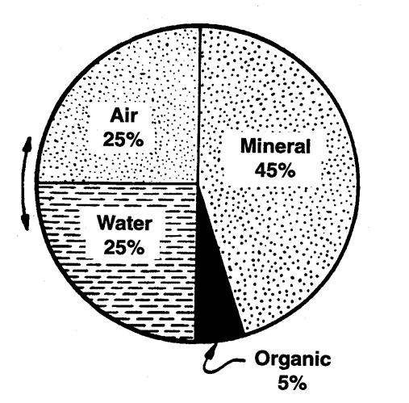
Optimum Soil

Slide 11
How do we have good or bad soils?
Can we loose soil? How?
Can we stop this?

Slide 13
Soil conservation
The biggest threat to our land is soil erosion.
Erosion is a natural process and takes place at all times on soil.

Slide 15
Causes of Erosion
It is when we disturb or alter the soil that it can increase it potential for erosion.
Soil are disturbed when we plow, plant, cut trees, remove natural vegetation, or build.

Slide 16
Erosion
The two major types of erosion are:
Sheet erosion – loss of an fairly uniform layer of the soil surface often without noticeable gullying.
Gully erosion – loss of soil in larger, often impassible trenches or ditches from runoff.

Slide 17
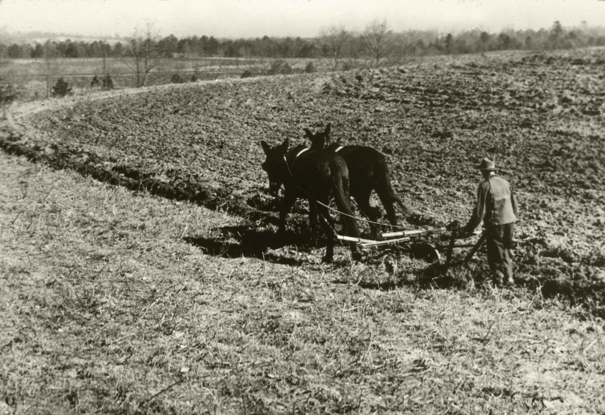
The primary causes of erosion are:
Water runoff
Wind
Man

Slide 18
Soil Conservation
How can we use our soil, yet conserve it or leave it where nature intended it to be left?
Conventional tillage practices vs:
Contour farming
Strip cropping
Waterways
Covercrops

Slide 19
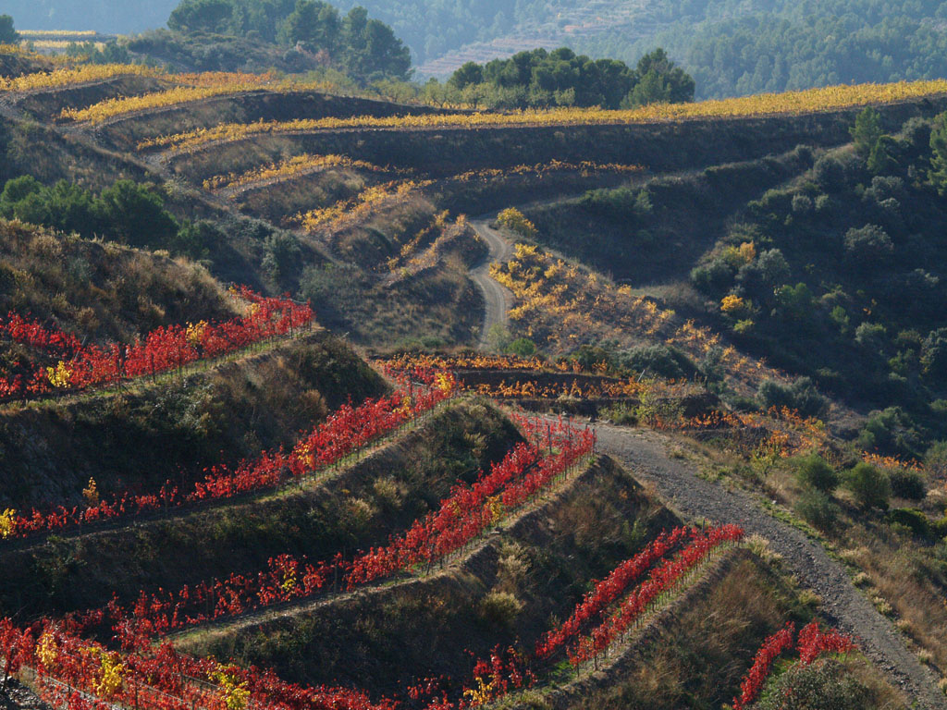
Contour Farming

Slide 20
Cover Crops

Slide 21
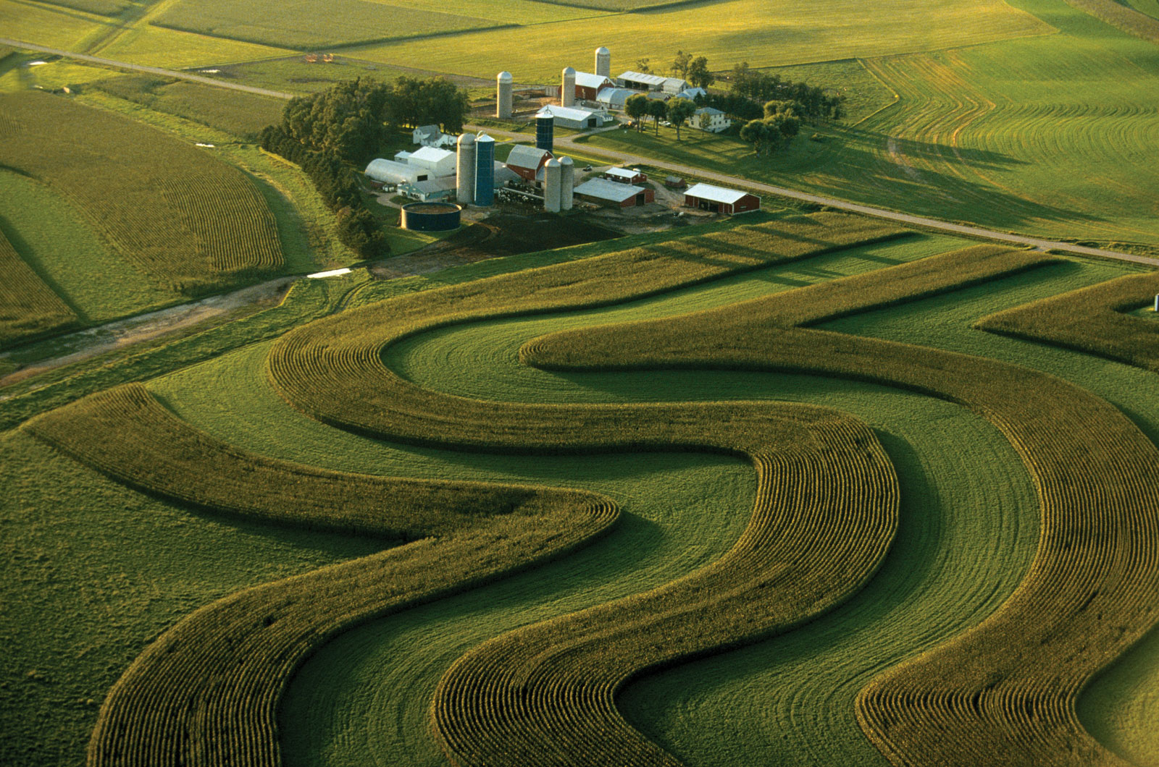
Strip and Contour Farming

Slide 22
Conservation Tillage Methods
No-Till – Planting crops directly into residue of the previous crop without plowing
Use of chemicals to control weeds verses plowing.
Windrows – rows of trees to knock down wind.
Crop rotations

Slide 23
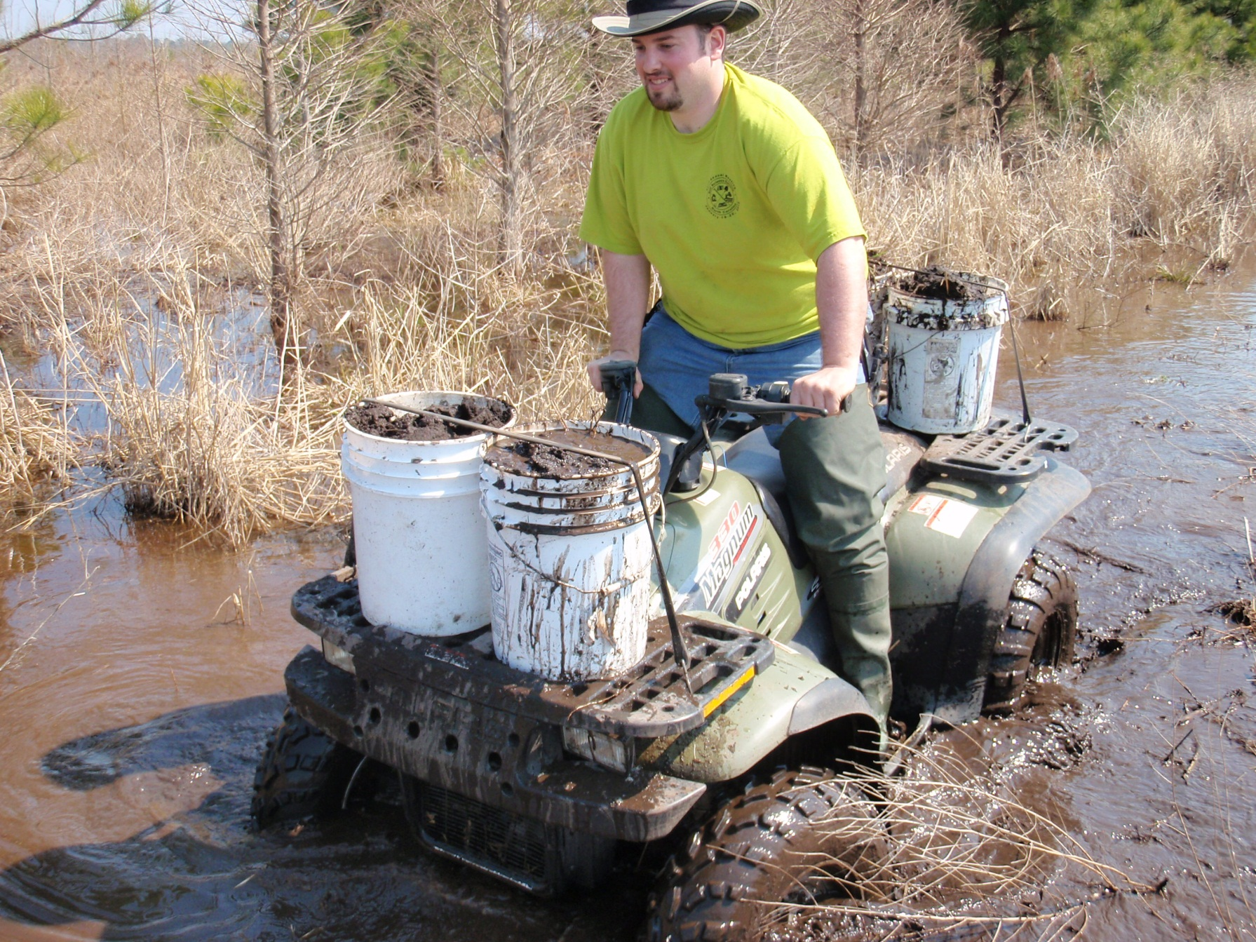
Soil Careers
Notes:
http://colbyandstacy.wordpress.com/2010/03/09/pictures-from-the-field-soil-collection-for-colbys-phd/

Slide 24
Careers for various education levels
Bachelor’s degree would be the minimum for:
Soil scientist- classify soil according to the most appropriate use
Soil conservation- assist landowners in implementing best land use practices

Slide 25
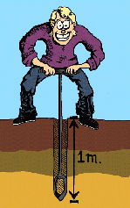
Careers for various education levels
Less than 4 year college degree:
Soil technician- uses soil auger/ soil tube to take soil samples and do field work
Equipment Operation – using large earth moving equipment to move and alter the landscape.

Slide 26
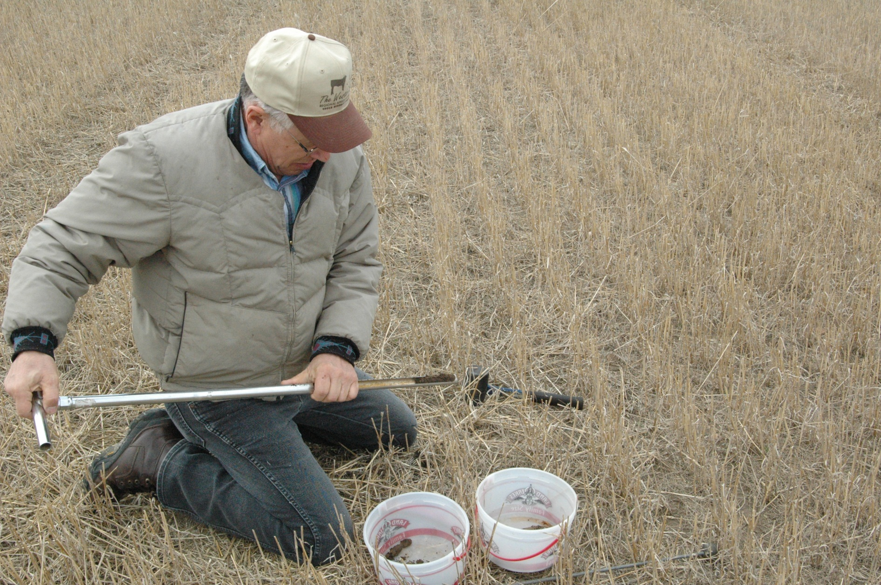
Soil Scientist

Slide 27
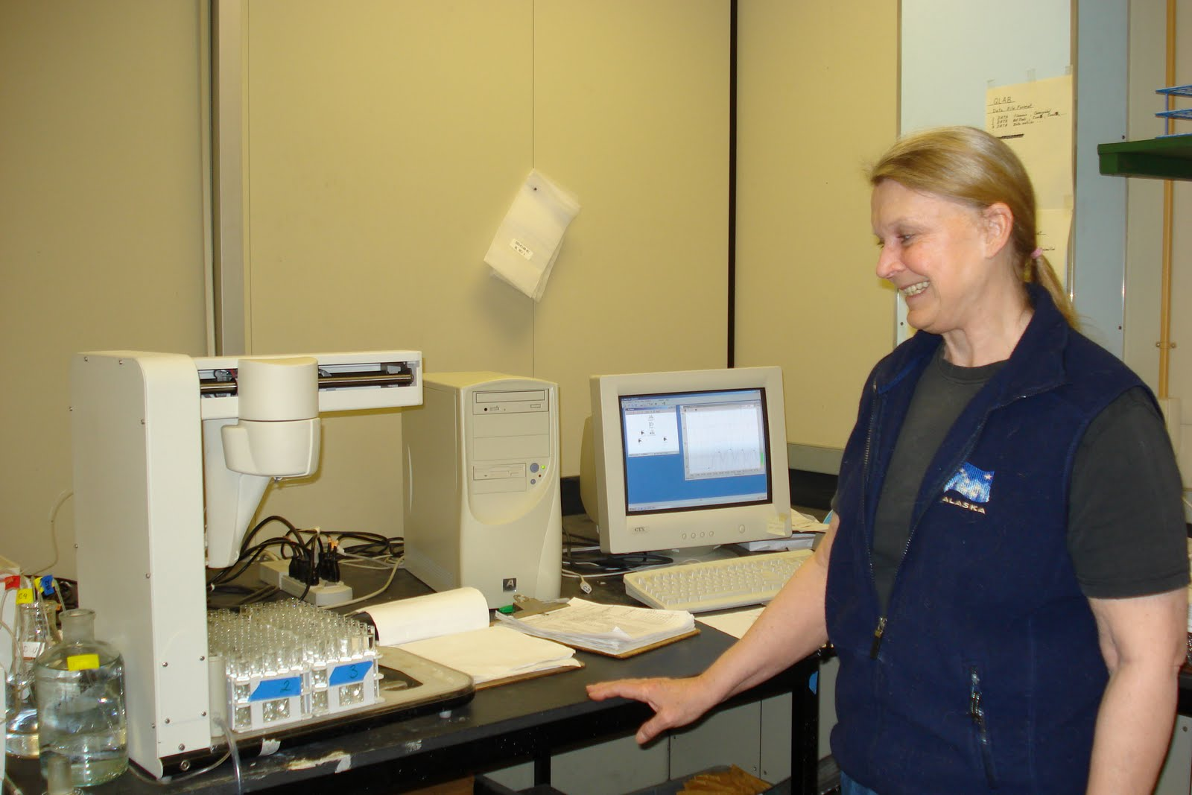
Soil Lab Technician-works for NCDA

Slide 28
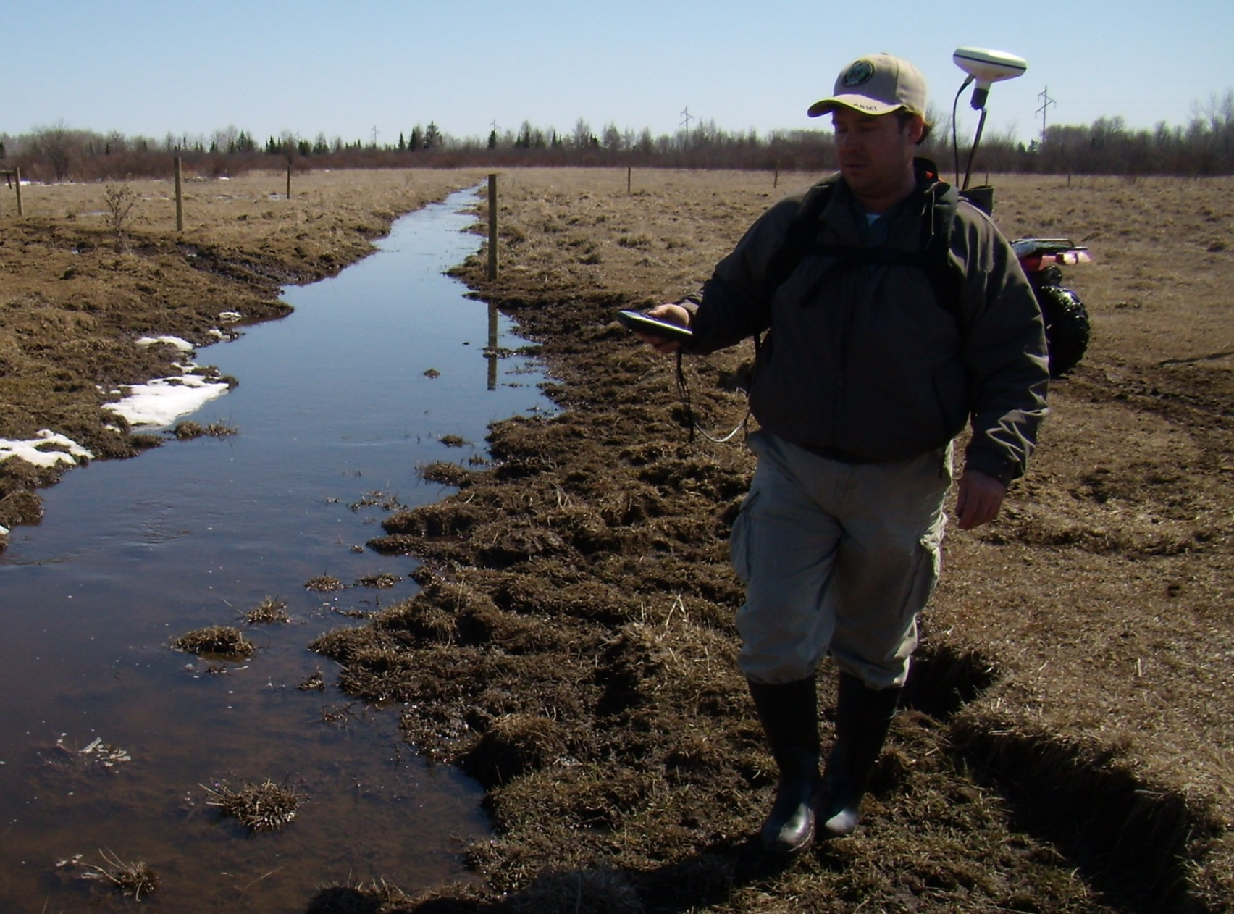
Soil Conservation Technician

